Slide 1
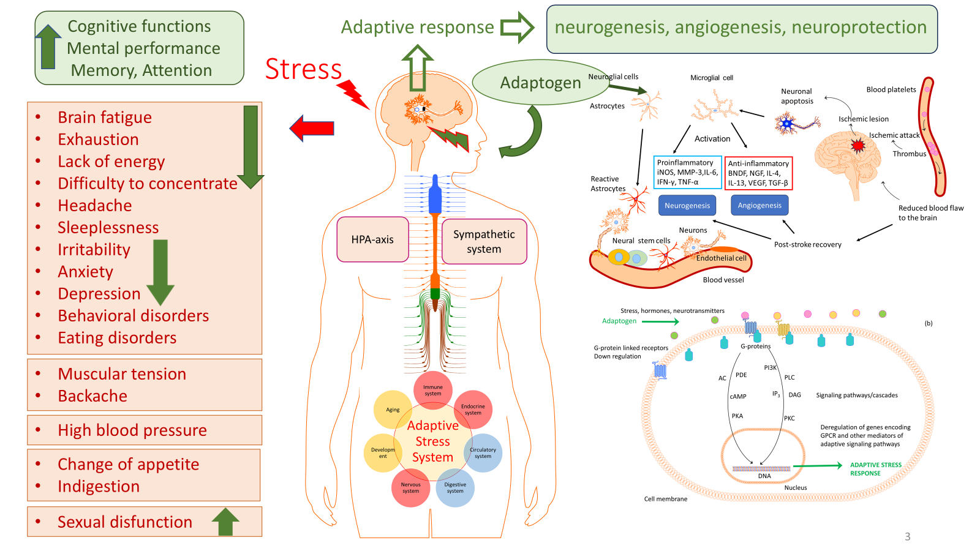
Stress-initiated stroke-induced long-lasting brain fatigue

