Slide 1


Adaptogenic plants for stress and ageing related disorders
Alexander George Panossian, PhD, Dr.Sci.
V International Congress
of the Spanish Society
of Nutrition and Orthomolecular Medicine
Madrid, 5-8th March 2020

Slide 2
Adaptogens: definitions
Adaptogens are natural stress-protective compounds or plant extracts that increase adaptability, resilience and survival of organisms.
Adaptability - ability of an organism to alter itself or its responses to the changed circumstances or environment.
Resilience - ability to recover readily from illness, depression, adversity or difficulties.
Adaptogens - compounds which could increase “the state of non-specific resistance” of organisms.
“Shanghuo” – as a state of increased susceptibility to stress and progression of diseases.

Slide 3
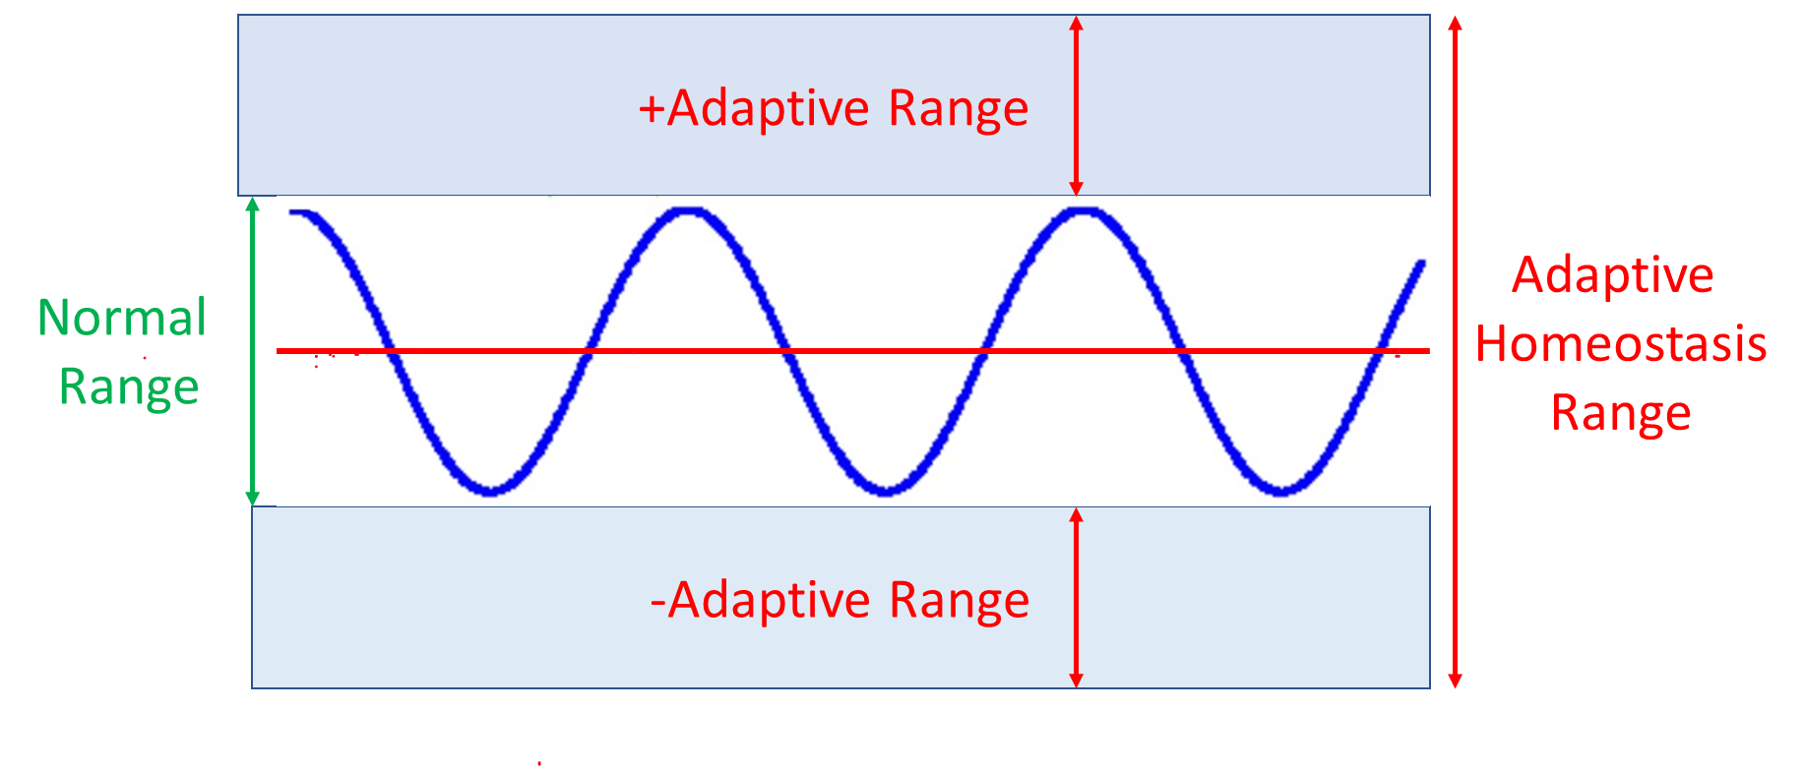
Adaptive homeostasis and homeostatic range
Chronically increased stress-responsive activity and
increased CRH secretion is associated with:
Any biological function, component, molecule, e.g. cortisol, CRH etc. oscillate around a mean or median, within a homeostatic range that is considered a ‘normal’
- increased arousal or anxiety,
- increased blood pressure, tachycardia
- gastrointestinal dysfunction,
immune suppression,
melancholic depression,
suppression of feeding (anorexia),
loss of libido
chronic active alcoholism,
alcohol and narcotic withdrawal,
excessive exercising and malnutrition,
Adaptogenic effect
Adaptogenic effect
Chronically decreased stress-responsive activity and
decreased CRH secretion is associated with:
- decreased arousal and performance of task,
- the chronic fatigue,
- fibromyalgia syndromes,
- increase in appetite and weight gain,
- somnolence, etc.
Adaptive Homeostasis is the transient reversible adjustments of the homeostatic range in response to exposure to mild stressors ( e.g. exercise or adaptogens).

Slide 4
Adaptogens like physical exercise adjust the homeostatic range
Adaptogens are eustressors
(“good stressors”) - mild stressors, stress-mimetics, or challengers
‘nonspecific stress- vaccines’,
inducing stimulating (stress-agonising)
and stress-protective effect against subsequent stress.
Adaptive
Homeostasis
Homeostasis

Slide 5
The difference between stimulants and adaptogens
 | Stimulants | Adaptogens
Stress protective (neuro-, hepato-, cardio-protective) | No | High
Recovery process after exhaustive physical load | Low | High
Energy depletion | Yes | No
Performance in stress | - | Increased
Survival in stress | - | Increased
Quality of arousal | Poor | Good
Addiction potential | Yes | No
Side effects | Yes | Rare
DNA/proteins synthesis | Decreased | Increased
NPY mediated activation of Hsp70 | - | Increased

Slide 6
Adaptogens
  Pharmacological activity: adaptogenic
  Health claims and indications for use:
    stress-induced fatigue,
    stress-induced mental and behavioral disorders,
    aging associated diseases.

Slide 7



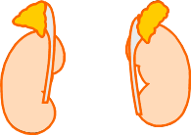
Chronic stress induced symptoms
Stress
Adaptogen
Cognitive functions
Endurance
Fatigue
Exhaustion
Lack of energy
Difficulty to concentrate
Headache
Sleeplessness
Irritability
Anxiety
Depression
Behavioral disorders
Eating disorders
Mental performance:
Attention
Memory
Physical performance:
Working capacity
Precision
Recovery
Stress system:
Neuro-
Endocrine-
Immune
complex
Muscular tension
Backache
High blood pressure
Change of appetite
Indigestion
Sexual disfunction

Slide 8
Age related diseases are health problems in senescence due to decreased adaptability to stress and an ability to maintain homeostasis
Stress
neurodegenerative diseases (Alzheimer's disease, etc.)
atherosclerosis - thrombosis, infarction, stroke
cardiovascular disease and hypertension
cancer
degenerative joint disease (osteoarthritis)
type 2 diabetes, obesity
muscle degeneration (sarcopenia)
visual loss because of clouding of the lens (cataracts)
Low grade chronic systemic
inflammation / Inflammaging
cell degeneration
cellular senescence

Slide 9
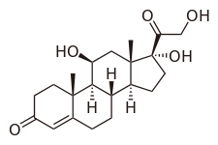

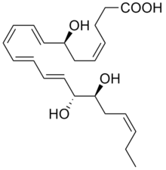
Chemistry of adaptogens
adrenalin
tyrosine
cortisol
resolvine
Salidroside
Oxylipins

Slide 10
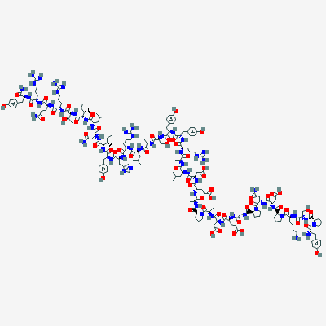
Effect of salidroside on expression of NPY in neuroglia cells
Panossian et al., Frontiers I neuroendocrine science 2012,

Slide 11
Plants reported in literature as adaptogenic and antistressor
1968 - 12
2003 - 34
Name of plant
Acanthopanax sessiliflorum Rupr.et Maxim.
Aralia manshurica Rupr.et Maxim
Aralia cordata Thunb
Aralia cordata var. sachalinensis (Regel) Nakai
Carlina biebersteinii Bernh
Echinopanax elatum Nakai
Eleutherococcus senticosis Maxim.,*
Kalopanax septemlobus (Thunb.) Koidz.
Panax ginseng C.A. Meyer
Rhaponticum carthamoides (Willd).Iljin,
Rhodiola rosea L.*,
Schizandra chinensis (Turcz.) Bail.*,
Name of plant | Family | Authors, year
Acanthopanax sessiliflorum Rupr.et Maxim. | Araliaceae | Brekhman and Dardimov, 1969
Albizzia julibrissin Durazz. | Fabaceae | Kinjo et al.,. 1991
Aralia elata (Miq) Seem. | Araliaceae | Hernandez et al., 1988
Aralia manshurica Rupr.et Maxim | Araliaceae | Baranov, 1982
Aralia schmidtii | Araliaceae | Baranov, 1982
Asparagus racemosus, | Liliaceae | Rege et al., 1999
Atragene sibirica L. | Ranunculaceae | Shilova et al., 2001
Azardirachta indica (Al, Neem), | Melaceae | Koner et al., 1997
Bergenia crassifolia (Fritsch), | Saxifragaceae | Suslov et al., 2002
Bryonia alba L.,* | Cucurbitaceae | Panossian et al., 1995
Cicer arietinum L. | Fabiaceae | Singh et al., 1983
Codonopsis pilosula (Franch.)Nannf. | Campanulaceae | Lin, 1991
Cordyceppt sinisis (Berk.) | Pyrenomycetales
Echinopanax elatum Nakai | Araliaceae | Baranov, 1982
Eleutherococcus senticosis Maxim.,* | Araliaceae | Brekhman and Dardimov,
Emblica officinalis,( Phyllanthus emblica L) | Euphorbiaceae | Xia et al., 1997; Rege et al., 1999
Eucommia ulmoides Oliver | Eucommiaceae | Oshima et al., 1988
Hoppea dichoroma Wild. | Gentianaceae | Ghosal et al., 1985
Ocimum sanctum L. | Lamiaceae | Bhargava and Singh, 1981
Panax ginseng C.A. Meyer | Araliaceae | Brekhman and Dardimov,
Pfaffia paniculata(Marius)Kuntze | Amarantaceae | De Oliveira, 1986
Rhaponticum carthamoides (Willd).Iljin, | Asteraceae | Brekhman and Dardimov, 1969
Rhodiola crenulaya (Hook, f. et Thoms) H.Ohba | Crassulaceae | Wang and Wang, 1992
Rhodiola rosea L.*, | Crassulaceae | Saratikov et al., 1968
Scutellaria baicalensis (Georgi) . | Lamiaceae | Suslov et al., 2002
Schizandra chinensis (Turcz.) Bail.*, | Magnoliaceae | Brekhman, 1980
Sterculia plantanifolia L. | Streculiaceae | Brekhman, 1980
Terminalia chebula | Combretaceae | Rege et al., 1999
Tinospora cordiflora Miers | Menispermaceae | Parel et al., 1978; Rege et al., 1999
Trichopus zeylanicus Gaerten. | Trichopodaceae | Singh et al., 2001
Withania somnifera L. | Solanaceae | Singh et al., 1982

Slide 12
2019: 111 plants reported in literature as adaptogenic
Acanthopanax sessiliflorum Rupr.et Maxim. | Azardirachta indica (Al, Neem), | Curcumin from Turmeric (Curcuma longa) | Heteropterys aphrodisiaca Machado | Mussanenda frondosa | Ptychopetalum olacoides Benth. | Solanum torvum SW.
Aegle marmelos | Bacopa monnieri (L.) Wettst | Dioscorea deltoidea Wall. ex Griseb. | Hibiscus cannabinus | Nelumbo nucifera Gaertn. | Pueiaria tuberosa Roxb | Sterculia plantanifolia L.
Ajuga turkestanica (Regel) Briq. | Bergenia crassifolia (L.) Fritsch | Diospyros peregrina gurke | Hippophae rhamnoides L. | Nigella sativa | Rhaponticum carthamoides (Willd.) Iljin | Sutherlandia frutescens (L.) R.Br.
Albizzia julibrissin Durazz. | Boerhaavia diffusa | Drypetes roxburghii (Wall.) Hurus. | Holoptelea integrifolia Planch | Ocimum sanctum L. | Rhodiola crenulaya (Hook, f. et Thoms) H.Ohba | Terminalia chebula Retz.
Alstonia scholaris (L.) R. Br. | Bryonia alba L. | Echinopanax elatum Nakai | Hoppea dichotoma Willd. | Oplopanax elatus (Nakai) Nakai | Rhodiola heterodonta (Hook. f. & Thomson) Boriss. | Tinospora cordifolia (Willd.) Miers
Allium sativum | Butea monosperma | Eleutherococcus senticosus (Rupr. & Maxim.) Maxim. | Hypericum perforatum L. | Panax ginseng C.A.Meyer. | Rhodiola imbricata | Tinospora malabarica
Anacyclus pyrethrum (L.) Lag. | Caesalpinia bonduc (L.) Roxb | Eleutherococcus sessiliflorus (Rupr. & Maxim.) S.Y.Hu | Labisia pumila | Panax notoginseng (Burk.) FH Chen | Rhodiola rosea L. | Tribulus terrestris
Andrographis paniculata (Burm.f.) Nees | Carum carvi | Emblica officinalis Gaetrn. | Lagenaria siceraria | Panax pseudoginseng Wall. | Rostellularia diffusa (Willd.) Nees . | Trichilia catigua A.Juss.
Annona muricata | Centella asiatica (L.) Urb. | Eucommia ulmoides Oliv. | Lepidium peruvianum/ Lepidium meyenii Walp. | Pandanus odoratissimus L.f. | Rubia cordifolia | Trichopus zeylanicus Gaertn.
Aralia elata (Miq) Seem. | Chlorophytum borivilianum Santapau & R.R.Fern. | Eugenia caryaphullus | Ligusticum striatum DC. | Paullinia cupana Kunth | Salvia miltiorrhiza Bunge | Trigonella foenom graecum
Aralia mandshurica Rupr. & Maxim | Chrysactinia mexicana A. Gray | Evolvulus alsinoides (L.) L. | Melilotus officinalis (L.) Pall. | Pfaffia paniculata (Mart.) Kuntze | Schisandra chinensis (Turcz.) Baill. | Tylophora indica
Aralia schmidtii | Cicer arietinum L. | Fagopyrum esculentum | Mitragyna africanus | Piper longum L. | Scutellaria baicalensis Georgi | Turnera diffusa Willd. ex Schult.
Argyreia nervosa (Burm. f.) Bojer | Cnestis ferruginea( | Firmiana simplex (L.) W.Wight | Momordica charantia | Polyalthia cerasoids | Serratula inermis | Vitis vinifera L.
Argyreia speciosa (L. f.) Sweet | Codonopsis pilosula (Franch.) Nannf. | Gentiana pedicellata (D.Don) Wall | Morus alba L. | Potentilla alba L. | Sida cordifolia L. | Withania somnifera (L.) Dunal
Asparagus racemosus Wild | Convolvulus prostratus Forssk. | Ginkgo biloba | Mucuna pruriens (L.) DC. | Prunella vulgaris | Silene italica (L.) Pers. | Zingiber officinale
Atragene sibirica L | Curculigo orchioides Gaertn. | Glycyrrhiza glabra L. | Murraya koenigii(Rutaceae) | Psidium guajava | Sinomenium acutum (Thunb.) Rehder & E.H.Wilson

Slide 13
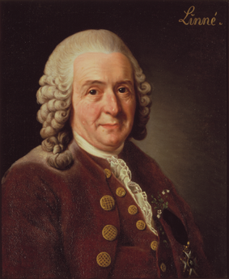
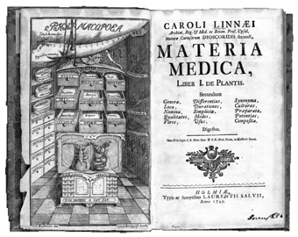
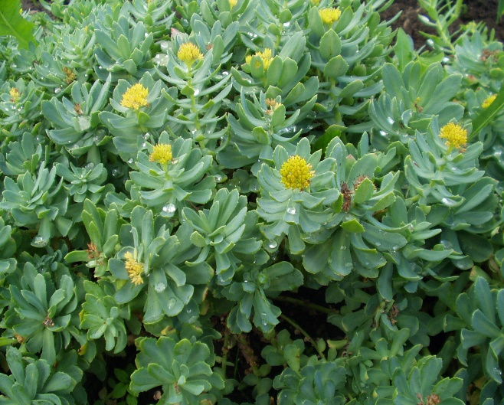

Rhodiola was described by Carl Linnaeus and included in the first Swedish Pharmacopoeia.
In the past , Vikings had used the herb to enhance their physical strength and endurance, restore weak nerves, “strengthen the head”
In Scandinavia, Rhodiola SHR-5 extract based traditional herbal medicinal product is recommended since 1987 as an adaptogen in case of decreased performance such as fatigue and sensation of weakness

Slide 14

Selected clinical trials of preparations of Rhodiola rosea roots
Pathophysiological condition: pharmacological activity | Reference | Study design | Quality of study | Evidence level | Grade
Physical fatigue | DeBock et al., 2004 | R, PC, DB, CO | 2 | Ib | B
 | Earnest et al., 2004 | R, PC, DB | 1 | IIa
 | Tuzov, 1968 | OL | 0 | IIb
 | Lapaev, 1982 | PC | 1 | III
Physical and cognitive deficiency in adults | Fintelman, 2007 | OL | 0 | III | B
Stimulating effect: Rhodiola can improve mental performance after single dose administration | Zotova, 1965 | PC | 1 | IIb | B
 | Marina et al., 1994 | OL | 0 | III
 | Komar et al, 1981 | PC | 1 | IIa
Mental fatigue: Rhodiola can improve attention in fatigue after single or repeated administration | Olsson et al., 2009 | R,PC,DB | 4 | Ib | A
 | Darbinyan et al., 2000 | R,PC,DB,CO | 4 | Ib
 | Spasov et al., 2000 | R,PC,DB | 4 | Ib
 | Shevtsov et al., 2003 | R,DB,PC | 3 | Ib

Slide 15
Selected clinical trials of preparations of Rhodiola rosea roots
Pathophysiological condition: pharmacological activity | Reference | Study design | Quality of study | Evidence level | Grade
Fatigue syndrome: Rhodiola has anti-fatigue effect in physical, emotional, and mental exhaustion | Olsson et al., 2009 | R,PC,DB | 4 | Ib | A
Mild depression: Rhodiola has an anti-depressive effect | Darbinyan et al., 2000 | R,PC,DB | 4 | Ib | A
 | Brichenko et al., 1987 | OL, C | 0 | Ib
Astheno-depressive syndrome and neurosis (stress-induced mild depression) | Krasik et al., 1970 | OL, UC | 0 | IIa | B
 | Mikhailova, 1983 | OL | 0 | IIa
 | Saratikov et al., 1965 ^{f} | OL | 0 | IIa
 | Mesheryakova, 1975 | OL | 0 | IIa
 | Kaliko and Tarasova, 1966 | PC, SB | 1 | IIa
Anxiety: Improvement in anxiety symptoms | Bystritsky et al., 2008 | OL | O | IIb | C

Slide 16
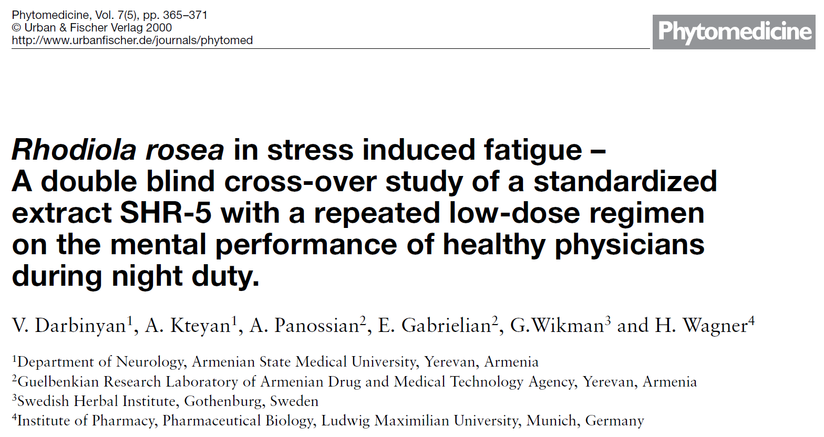
Two weeks treatment of healthy subjects with Rhodiola rosea SHR-5 extract improves their cognitive functions and reduces non-pathological fatigue under certain stressful conditions.
The phase III, randomised, double-blind, placebo-controlled, cross-over trial.
Participants: 56 males and females aged 24-35 years
SHR-5 extract: 175 mg (4.5 mg salidroside) day (one tablet / day), 14 days
Placebo: one tablet / day), 14 days

Slide 17
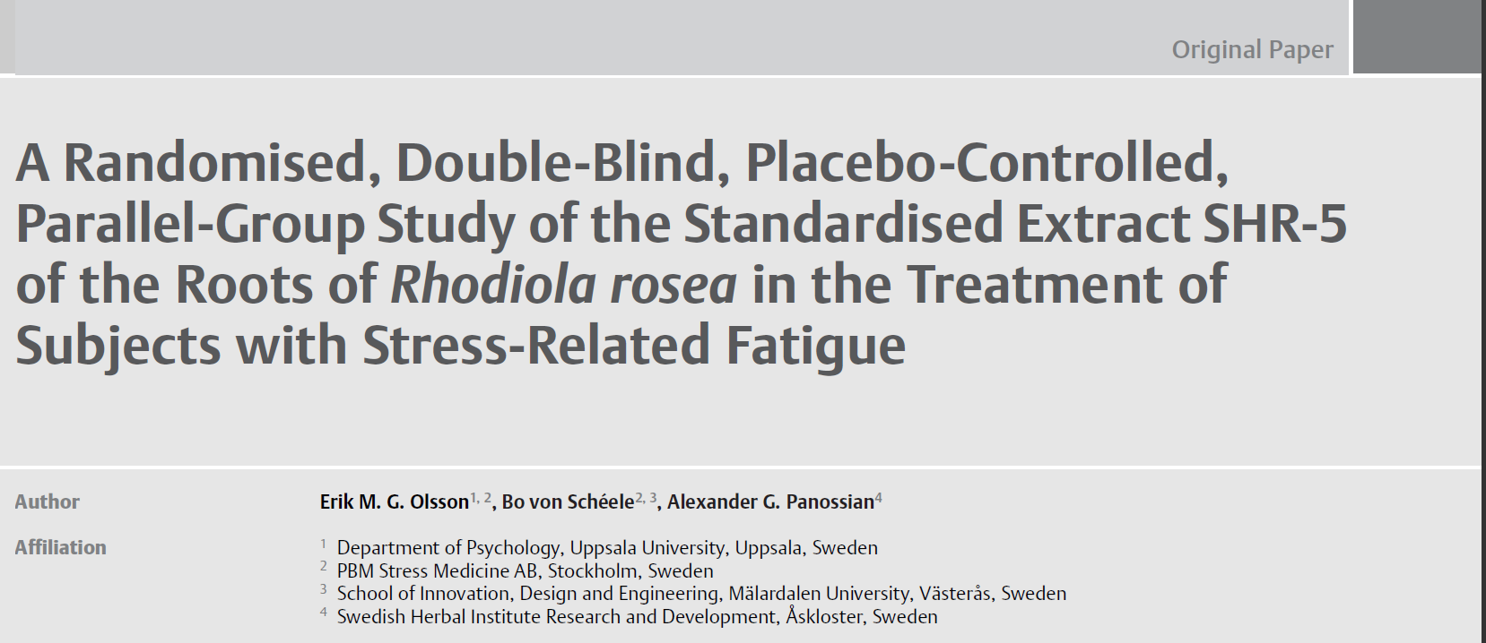
Planta Medica, 2008, 75(2):105-112.
The phase III, randomised, double-blind, placebo-controlled, with parallel groups clinical trial.
Participants: 60 males and females aged 20-55 years
SHR-5 extract, 576 mg extract / day (2 tablets 2 times / day), 28 days
Olsson EMG, von Schéele B, Panossian AG. Planta medica, 2009

Slide 18
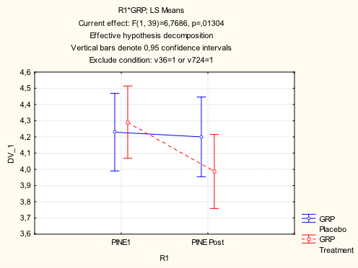
Efficacy primary endpoint: burnout score – the level of physical, emotional, and mental exhaustion
Pines & Aronson Burnout Measure of burnout includes 21 items,
evaluated on 7-point frequency scales
Pines’ burnout score, AU
P < 0.05
Olsson EMG, von Schéele B, Panossian AG. Planta medica, 2009

Slide 19
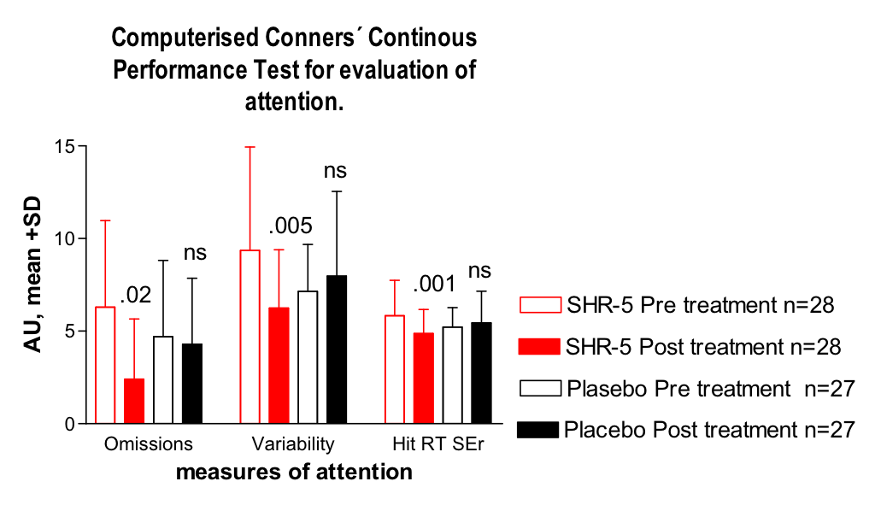
Efficacy secondary endpoints: attention
An omission is when you don’t respond when you should have done so.
Variability is an index of work pace stability - better attention.
Hit RT SE is the standard error of the reaction time. A lower standard error indicates a more stable work pace - better attention.
Olsson EMG, von Schéele B, Panossian AG. Planta medica, 2009

Slide 20
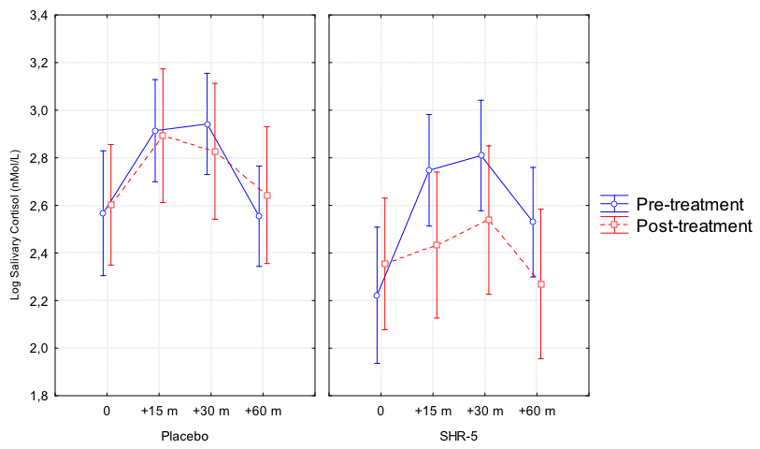
Efficacy secondary endpoints: cortisol response to awakening
Olsson EMG, von Schéele B, Panossian AG. Planta medica, 2009

Slide 21
Clinical trial of Rhodiola rosea L. extract SHR-5 in the treatment of mild to moderate depression
The phase III, randomised, double-blind, placebo-controlled, with parallel groups clinical trial.
Participants: males and females aged 18-70 years, with initial HAMD scores between 21-31.
Group A ( n = 31) Rhodiola, 2 tablets
Group B (n = 29) Rhodiola, 4 tablets
Group C (n = 29) placebo
Duration of the treatment: over 6 weeks.
Darbinyan V, Aslanyan G, Amroyan E, Gabrielyan E, Malmstro¨m C, Panossian A.
Nordic Journal of Psychiatry 2007; 61:343- 348. Oslo. ISSN 0803-9488.

Slide 22
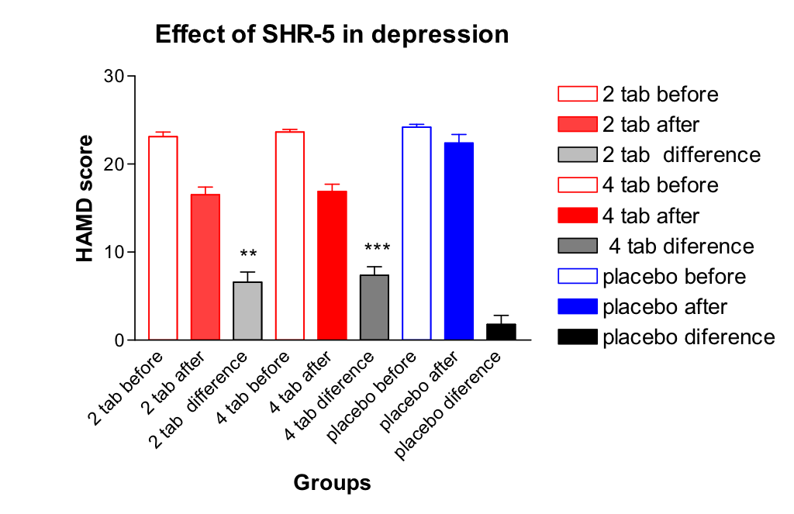
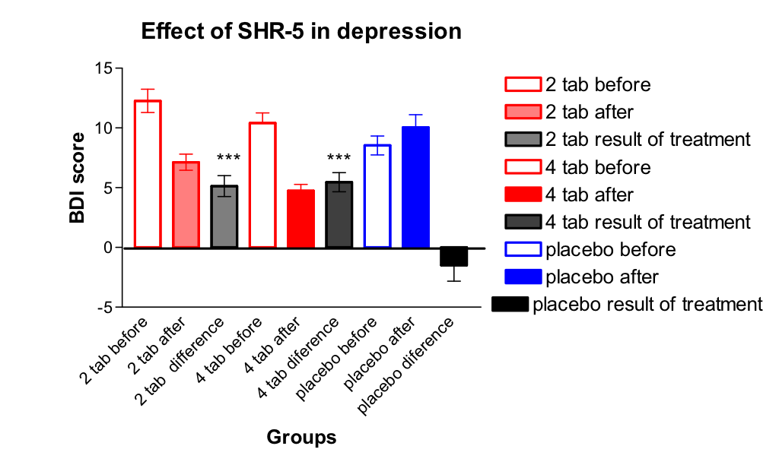
Efficacy primary endpoints: HAMD and BDI scores
Darbinyan et al., Nordic J. Psychiatry, 2009

Slide 23
The efficacy and safety of SHR-5 and other SHI products was demonstrated in clinical studies on humans and preclinical studies on animals.
The efficacy of these products is evidence based.
The results obtained on SHR-5 can not be extrapolated on any Rhodiola preparation and similar products produced by other manufacturers
Why ?

Slide 24
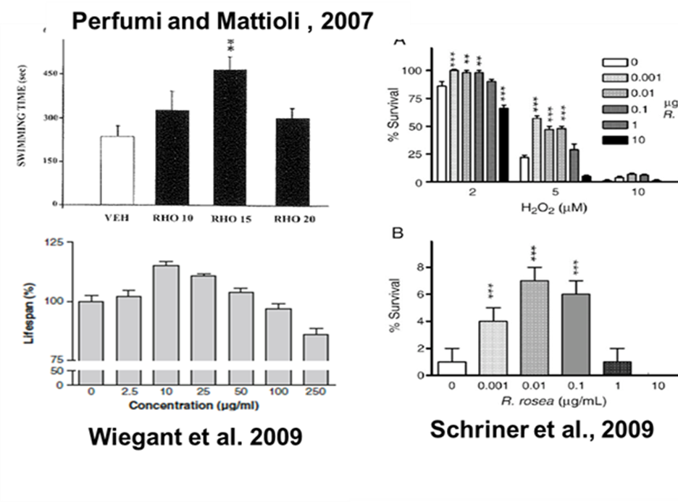
Why sometimes we have contradictory results from different studies where “the same” preparations from different manufacturers were used?
Because the dose-effect dependence of active ingredients (like in Rhodiola extract) is not linear and has a bell shape
Consequently, the dose which is efficient in one study with one preparation could be not efficient in another one with another extract.
Because the composition and the content of active constituents is quit different in various medications used in the clinical studies,

Slide 25
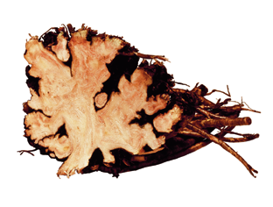
Chemical composition of herbal preparation depends on numerous factors:
Genetic factors - chemical races variability,
Environmental factors
    Climate (temperature, light, rain),
    soil (pH, fertilization, heavy metals),
    insects, pest, microbiological infection
    Part of plant (root, bark, leaf, fruit, etc)
Treatment of raw material to produce drug substances
    Pulverisation (fine coarse cut, grinding temperature)
    Extraction (solvent polarity, temperature, duration)
    Distillation (temperature)
    Expression (temperature)
    Fermentation (temperature duration)
    Purification (removal of undesired components like sugars, resins, chlorophylls, etc.
Storage
    Light, oxygen (radical building, self-oxidation),
    Humidity (hydrolysis, enzymatic transformations, microbiological infection)
    Temperature (polymerization, decomposition, microbiological transformation

Slide 26
HPTLC comparison of Rhodiola products suspected of adulteration SHR-5
Samples 2,3,8,13,15,17,21 are all adulterated products,
Sample 11 is a THR product –SHR-5,
Sample 20 is an expired product.
Booker et al. 2016. The authenticity and quality of Rhodiola rosea products. Phytomedicine. 23, 754-762 .

Slide 27
Variation of Rhodiola products – HPTLC fingerprints
HPTLC results for all Rhodiola market samples, mobilephase[Ethylacetate,methanol,water,formicacid(77:13:10:2)].
Booker et al. ComparativeQualityStudyof Rhodiola Species

Slide 28
Content of Active Ingredients in Selected Rhodiola Commercial Products*
Fill Weight mg/cap |  | Salidroside mg/mg fill | Rosavin mg/mg fill | Total Rosavins mg/mg fill | Manufacturer’s Claim
305.6 | Found Claim | 6.3 mg/cap 3.0 mg/cap | 4.6 mg/cap 12.0 mg | 16.3 mg/cap 24 mg/cap | 300 mg 5.4-6.6% total rosavins, 3.6-4.4% rosavin, 0.9-1.1% salidroside
333.3 | Found Claim | 2.0 mg/cap 1.0 mg/cap | 0.3 mg/cap 1.0 mg/cap | 0.8 mg/cap | 100 mg extract, 1 mg (1%) rosavins, 1mg (1%) salidroside
313.0 | Found Claim |  |  | 4.9 mg/cap 9.75 mg/cap | 150 mg rosavins = 3.5% total rosavins
553.0 | Found Claim | 4.1 mg/cap 5.0 mg/cap |  | 10.7 mg/cap 15.0 mg/cap | 500 mg extract, 3% rosavins, 1% salidroside
158.9 | Found Claim | 3.7 mg/cap 1.5 mg/cap | 1.9 mg/cap 3.0 mg/cap | 7.0 mg/cap | 150 mg rhodiola, 3% rosavins, 1% salidroside, 0.1% tyrosol
277.3 | Found Claim | 2.1 mg/cap 2.0 mg/cap | 2.1 mg/cap | 6.2 mg/cap 6.1 mg/cap | 205 mg extract, 3% rosavins, 1% salidroside
* Adapted from: Semple HA, NHP Research Targeted Toward Commercialization: Application of the Field to Medicine Cabinet Concept.
7th NHPRS Research Conference, Halifax, Canada, May 23-26, 20107th NHPRS Research

Slide 29
Bioequivalence
“Rosenrot uncoated tablets 720 mg” (Naturapoteket ) are not bioequivalent to the reference “Rosenrot” (Swedish Herbal Institute), film-coated tablets 500 mg, when orally administrated in equivalent doses.

Slide 30
Therefore the results of therapeutic efficacy obtained on SHR-5 can not be extrapolated on any Rhodiola preparation and similar products produced by other manufacturers
It is a challenge to produce standardized extracts with reproducible chemical composition, and consequently with reproducible pharmacological activity, particularly when extracts are produced by different manufacturers.
Multicomponent herbal medicinal products manufactured from the same plant can not be absolutely identical as it is in case of active pharmaceutical ingredients with ONE single compound.

Slide 31
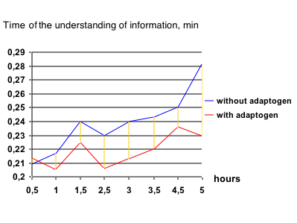
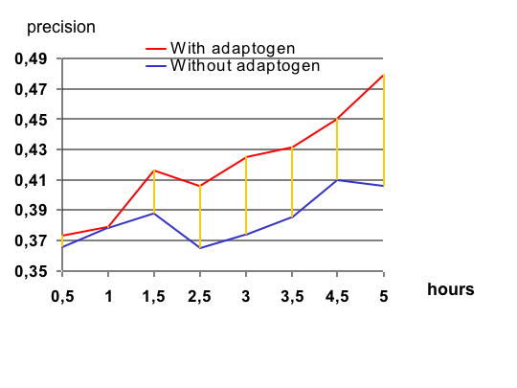


ADAPT-232 is a fixed combination of extracts from
  Rhodiola rosea roots,
  Schisandra chinensis berry
  Eleutherococcus senticosus root
registered in Sweden as a Traditional Herbal Medicinal Product and indicated as adaptogen in fatigue and feeling of weakness.
Yuri Usachev
Valery Polyakov
The dynamics of object fixation: speed and precision assessed 30 minutes after intake of ADAPT-232 and for the following 4.5 h.

Slide 32
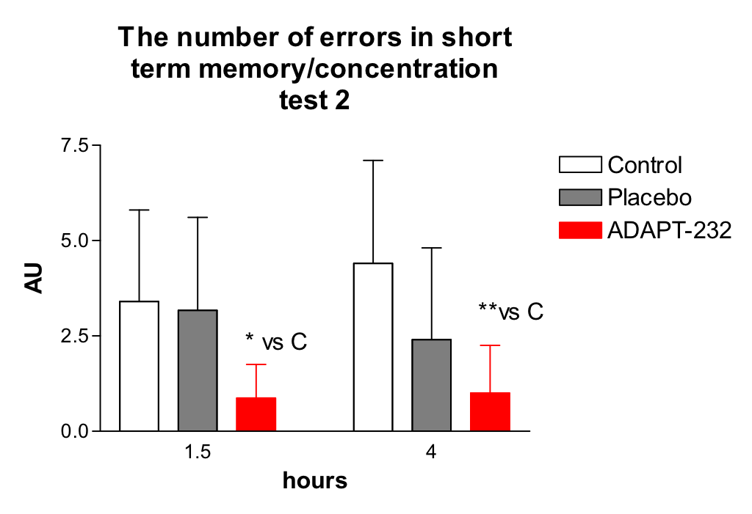
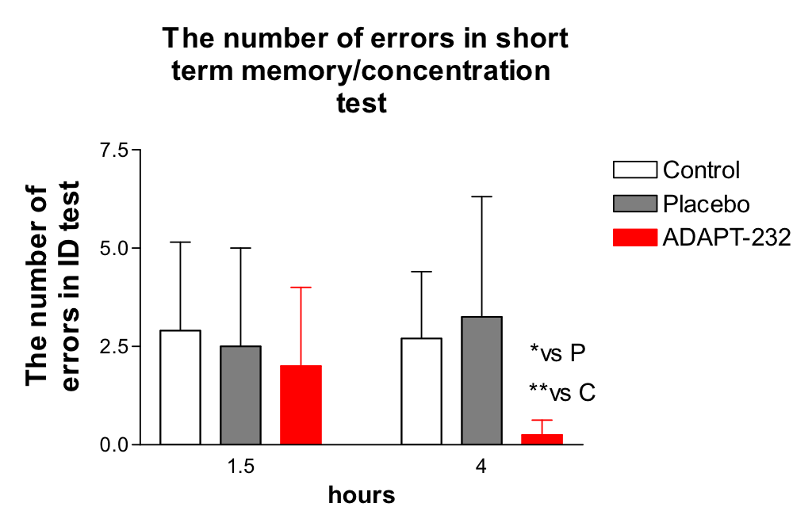
Effect of ADAPT232 on cognitive functions
of healthy subjects – the concentration, oculomotor co-ordination and short-term memory of cosmonauts
ADAPT-232 significantly improved attention and ability to concentrate expressed as a decrease in errors made and an increase speed and accuracy of performance stressful cognitive tasks in various psychometric tests, in cosmonauts

Slide 33
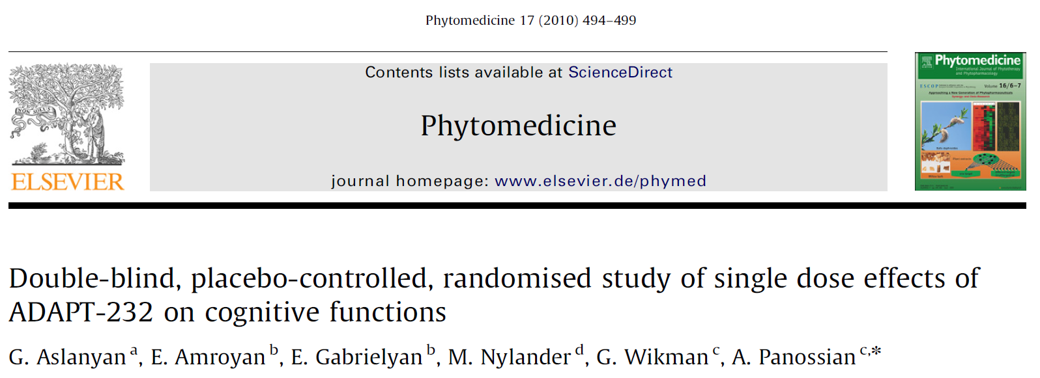
The phase III, randomized, double-blind, placebo-controlled, with parallel groups clinical trial.
Participants: 40 healthy females aged 20-68 years
  who claimed to have felt stressed over a long period of time by virtue of living under psychologically stressful conditions and
  submitted to stressful cognitive tasks, namely, the Stroop Color-Word test (Stroop CW) followed by the d2 Test of Attention (d2), before and 2 h after treatment
ADAPT-232, 270 mg, one tablet before the tests

Slide 34
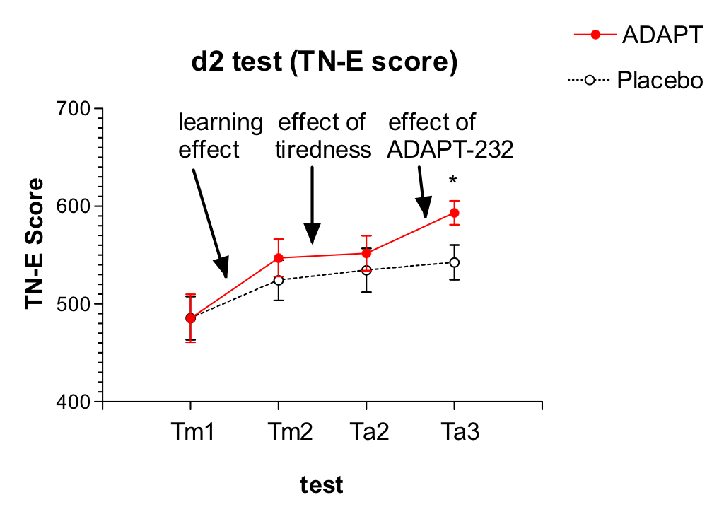
Single dose effects of ADAPT-232 on cognitive functions
Total Number of items processed for 4 min 40 sec | TN
Total Errors | E
Concentration Performance: Number of correct items worked through | TN-E
Concentration Performance (TN-E) score is a neuropsychological measure of selective and sustained attention and visual scanning speed obtained by the Test of Attention (d2 test).

Slide 35
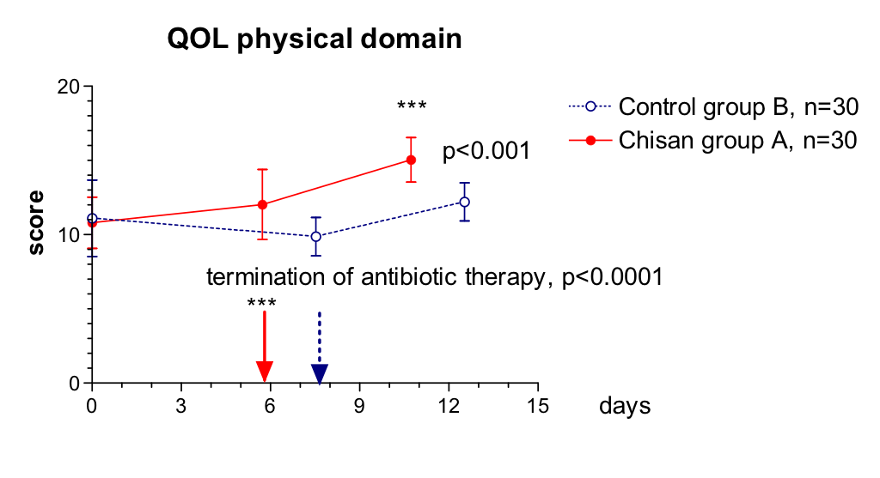
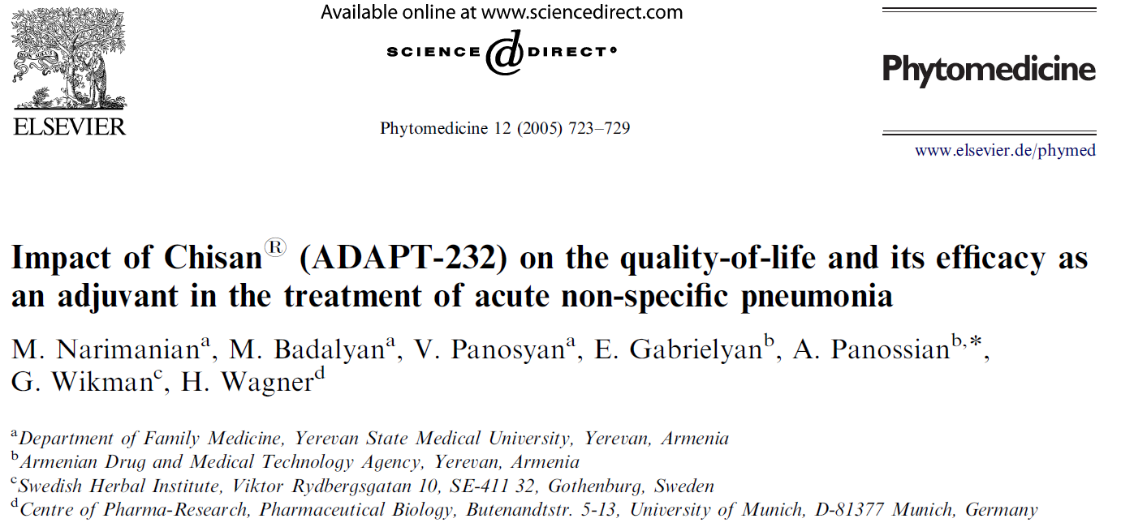

WHO- Quality of life- questionnaire scores of patients undergoing a standard treatment for acute non-specific pneumonia and receiving either adjuvant therapy with ADAPT-232 or placebo
Physical health
Psychological
Social relationships
Environment
Recovery

Slide 36

Efficacy of Adaptogenic Supplements on Adapting to Stress: a randomized, double blind, placebo controlled trial
ADAPT 232
ADAPT-Sport -
Dose: 2 capsules x 2 times a day
Duration of treatment: 30 days.
Participants: 215 male and female elite athletes aged 18-35 years

Slide 37

Efficacy secondary endpoints: Fatigue, Perceived Stress and Burnout level
Improvement

Slide 38

Efficacy: physical performance

Slide 39
Efficacy secondary endpoints: post-exercise recovery

Slide 40
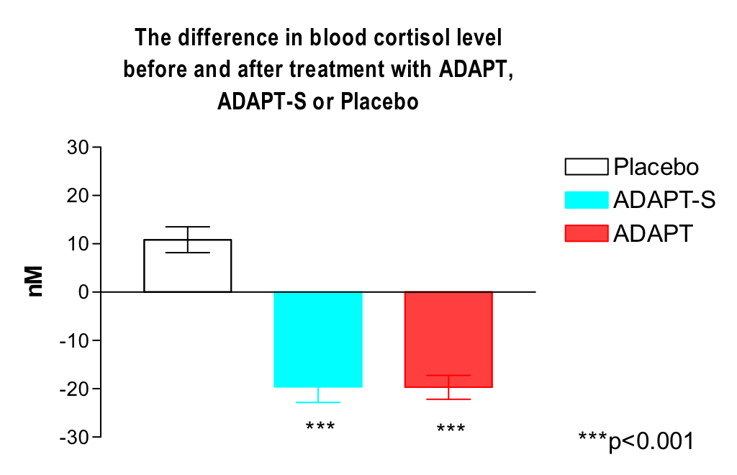
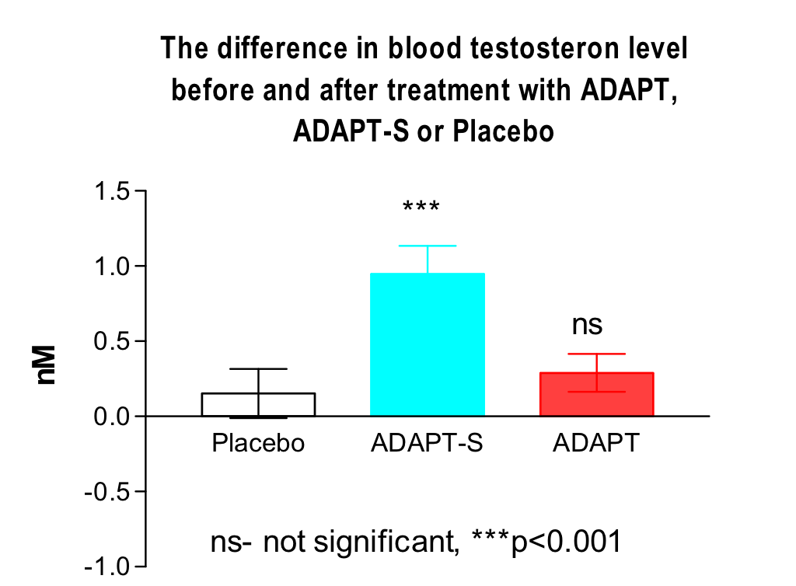
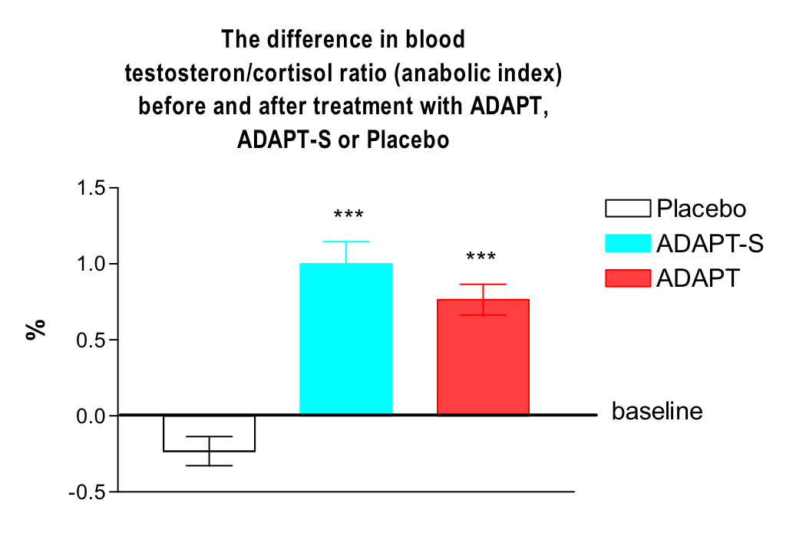


Efficacy primary endpoints: testosterone, cortisol and anabolic index
ADAPT-232 (n=92) | Mean ± SEM |  | P value | Difference
 | BEFORE | AFTER
Cortisol(nmol/L) | 249.7 ± 4.234 | 230.0 ± 4.056 | 0,001 | ***
Testosterone total (nmol/L) | 16.62 ± 0.229 | 16.91 ± 0.252 | 0,39 | ns
Insulin (µIU/mL) | 13.98 ± 0.360 | 14.96 ± 0.412 | 0,076 | ns
IGF-1(ng/ml) | 225.6 ± 6.338 | 261.1 ± 5.878 | 0.0001 | ***
Immunoglobulin A (mg/dL) | 148.1 ± 3.873 | 153.6 ± 3.942 | 0,32 | ns
T3 (ng/ml) | 1.112 ± 0.017 | 1.117 ± 0.016 | 0,84 | ns
T4 (ng/ml) | 7.971 ± 0.142 | 8.110 ± 0.139 | 0,48 | ns
TSH (mIU/L) | 1.527 ± 0.061 | 1.639 ± 0.065 | 0,21 | ns
Testosterone/Cortisol Ratio (%) | 6.712 ± 0.130 | 7.476 ± 0.176 | 0,0006 | ***
ADAPT-S (n=55) | Mean ± SEM |  | P value | Difference
 | BEFORE | AFTER
Cortisol(nmol/L) | 254.5 ± 6.036 | 234.9 ± 5.372 | 0,02 | *
Testosterone total (nmol/L) | 16.73 ± 0.381 | 17.70 ± 0.396 | 0,08 | ns
Insulin (µIU/mL) | 14.43 ± 0.518 | 15.42 ± 0.515 | 0,18 | ns
IGF-1(ng/ml) | 240.6 ± 7.738 | 280.0 ± 6.158 | 0,0001 | ***
Immunoglobulin A (mg/dL) | 142.7 ± 4.452 | 157.1 ± 5.056 | 0,03 | *
T3 (ng/ml) | 1.131 ± 0.026 | 1.141 ± 0.025 | 0,79 | ns
T4 (ng/ml) | 8.248 ± 0.204 | 9.803 ± 1.609 | 0,34 | ns
TSH (mIU/L) | 1.579 ± 0.073 | 1.145 ± 0.026 | 0,91 | ns
Testosterone/Cortisol Ratio (%) | 6.702 ± 0.168 | 7.718 ± 0.231 | 0,0005 | ***

Slide 41
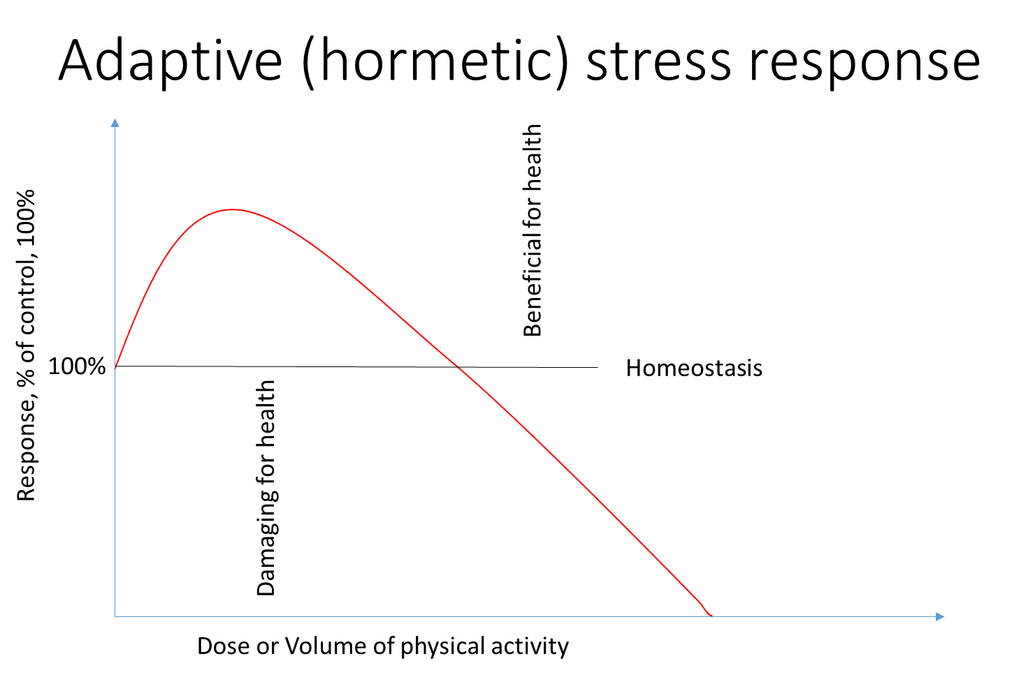
Stress-protective effect of ADAPT-232 in C.elegans
ADAPT-232 increases survival of C. elegance treated with heat shock at the seventh day of their life span in a dose dependent manner
This phenomenon has been commonly observed in biology and medicine, and has been described as adaptive stress response, preconditioning, ‘hormesis’ or adaptive homeostasis
Control heat shock

Slide 42
Key points in understanding adaptogenic activity
Evolutionary, adaptogens together with other plant secondary metabolites play a role in defense and adaptive response against various environmental stressors including physical (e.g., intense sunlight, UV, darkness, heat, cold), chemical, and biological (e.g., microorganisms, insects and other pests) .
At the relatively small doses these natural compounds are not toxic in humans, but still induce mild cellular stress responses.
One basic mechanism of action of adaptogens that is that they activate adaptive stress response in humans .
Adaptogens trigger adaptive stress response by stimulating cellular and organismal defense systems, activating intracellular and extracellular adaptive signaling pathways, expression of stress-activated proteins, resulting in transient change in protection or repair capacity and increased of non-specific resistance and adaptation to stress.

Slide 43
Mediators and effectors of adaptive stress response signaling system regulated by adaptogens
MEDIATORS OF CELL ADAPTIVE STRESS RESPONSE SIGNALING SYSTEM
Hormones: CRH, UCN, GNRH1
Receptors: GPCR (CHRM4, VIPR2), TLR9, PRLR , CHNRE, RORA
Ion channels: Ca+2 and K+ voltage-gated channels proteins, etc.
Enzymes (PLC, AC,GC) and second messengers (IP3, DAG, cAMP)
Kinases: PKC, PI3K, MAPK10, MAPK13, PRKCH
Phosphatases: PTPRD, PTPRR
  Transcription and nuclear factors: STAT5A , FOS, FOX0, SCX, Nrf-2, CREB, NF-kB, Zinc finger proteins
ADAPTIVE STRESS RESPONSE FACTORS
exercise
dietary energy restriction
nutrition and medications, adaptogens
cognitive stimulation / emotions
toxins
radiation
temperature
ADAPTIVE STRESS RESPONSE EFFECTORS
Antioxidant enzymatic system: superoxide dismutase, catalase. glutathione peroxidase
Protein chaperones, growth factors and defense response proteins: HSP-70, HSPA6, STIP1, PDE9A, PDE3B, GUCY1A2, LDHD, CEL, AOC3, LIPE, etc.

Slide 44
Effect of adaptogens on HPA axis hormones encoding genes expression
Diseases and disorders
major depression, mood disorder,
psychosis,
cognitive impairment,
seizures,
hyperglycemia,
edema,
psoriasis,
acne,
anorexia, weight loss, weight gain,
  corticotropin releasing
  hormone
⬇ CRH
Diseases and disorders
hypogonadotropic hypogonadism,
female infertility,
gender identity disorder,
osteoporosis,
fatigue,
muscular atrophy,
sarcopenia,
systemic lupus erythematosus,
neoplasia
prostatic adenocarcinoma,
metastatic prostate cancer,
breast cancer,
⬆ GNRH1
  Gonadotropin releasing hormone 1

Slide 45
Transmembrane receptors
Biological processes
pathogen recognition
activation of innate immunity
defense response to bacteria and viruses;
inflammatory response;
maintenance of gastrointestinal epithelium;
male gonad development;
microglial cell activation and axonogenesis;
TLR9 ⬆
Toll-like receptor
Diseases and disorders
hyperprolactinemia,
cancer,
ulceration,
insulin resistance,
impaired glucose tolerance,
hyperleptinemia,
hyperglycemia,
hypoglycemia,
hypocalcemia,
hypoinsulinemia,
obesity.
  prolactin receptor
PRLR ⬇

Slide 46
Effects of adaptogens on adaptive stress response signaling pathways that protect neurons against degeneration and promote synaptic plasticity.
Exercise
GABA
Cognitive challenge
Hyperpolarisation
Calcium
Protection against excitotoxicity
Glutamate
Calcium
CaMKII
CREB
BNDF
DNA repair
Dietary energy restriction
Glutamate
Endoplasmic reticulum
Calcium
Energetic
tropic factors
UCPs
Hsp/chaperons
PMSC enzymes
ROS
Mitochondrion
NRF2
NF-kB
HO1
NOO1
SOD
Efferent neurons
Acetylcjoline
ATP
Serotonin
SIRT
HSF1
FOXO3
AOEs
Hsp70
c-AMP
CREB
BDNF
m-TOR
DAG, IP3, PKC
Calcium
BCL-2
Chaperons/Hsp70
Upregulation or activation
Downregulation or inhibition
Stranahan, A.M. &M.P.Mattson. 2012. Recruiting adaptive cellular stress responses for successful brain ageing. Nat. Rev. Neurosci. 13: 209–216.
Panossian A.G. 2017. Understanding adaptogenic activity: specificity of the pharmacological action of adaptogens and other phytochemicals. Ann. N.Y. Acad. Sci. 1401(1):49-64.

Slide 47
The effect of adaptogens on adaptive stress response signaling pathways
CD14
LPS
G-proteins coupled receptors
Receptor
tyrosine kinase
toll like receptor
Gαq-protein
Gαi-protein
Gαs-protein
PLC
PI3K
MEK
IP3
PIP₂
AC
PDE
PIP₃
Ca²⁺
MAPK
ATP
cAMP
AMP
DAG
Calmodulin
PDK1
Fos
JNK
PKA
AMPK
CaM-kinase
PKC
PKB-Akt
Gene regulatory proteins: transcription and nuclear factors (Nrf-2, FOXOs, CREB, NF-kB, AP-1)
Other target proteins

Slide 48
Effects of adaptogens on adaptive stress response in HPA axis
Extracellular signaling
Intracellular signaling
Activation of innate immunity,
adaptation to stress, survival, longevity, cognitive function
ADAPT-232
NPY
-C
FOXO
Hsp
70
Stress
Neuroglia cell
ATP
Hsp70: Stimulation of immune system
Cytoprotective effect
Adaptation to stress,
Increased survival, lifespan, longevity and cognitive function
Hypothalamus
STOP
CRH
GR
STOP
JNK
STOP
NO
NPY: Regulation of HPA axis, maintaining energy balance, adaptation to stress,
increased survival, lifespan, longevity and cognitive function, anti-depressive, anxiolytic and antinarcotic effects. etc.
Pituitary
STOP
Cortisol
ACTH
Adrenaline
Stimulation
Adrenals
Inhibition

Slide 49
Definition based on the mechanisms of action
Criterias of adaptogenic activity
Mechanism of action. Multitarget effect on neuroendocrine-immune system including:
  triggering of intracellular and extracellular adaptive signaling pathways that promote cell survival and organismal resilience in stress
  regulation of metabolism and homeostasis via effects on expression of stress hormones (corticotropin and gonadotropin releasing hormones, urocortin, cortisol, neuropeptide Y, heat shock proteins Hsp70) and their receptors.
Panossian A, Seo EJ, Efferth T. Novel molecular mechanisms for the adaptogenic effects of herbal extracts on isolated brain cells using systems biology. Phytomedicine, 50 (2018) 257-284. https://doi.org/10.1016/j.phymed.2018.09.204
https://www.sciencedirect.com/science/article/pii/S0944711318304835?via%3Dihub

Slide 50
Adaptogens
How adaptogens save energy in stress?
Stress
NO
Aerobic glycolysis
Anaerobic glycolysis
Respiratory chain
Blood glucose
1 ATP
2 Acetyl-CoA
1 ATP
Krebs cycle
Glucose – 6P
2 pyruvic acid
Glycogen
2 lactic acid
34 ATP
4 ATP
Medium term performance
Long term performance

Slide 51
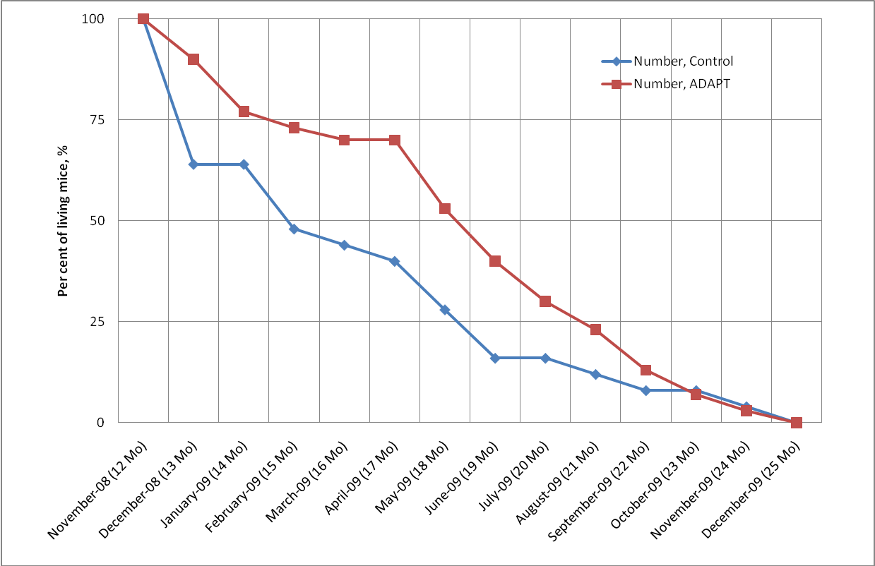
Why adaptogens are useful in ageing?
Effect of ADAPT on the lifespan of mice in stressful environment
Effect of ADAPT-232 on the lifespan of C.elegans
Panosyan L. and Wiegant FAC, 2005

Slide 52
Effect of ADAPT on ageing related disorders in two years old rats
A 4 months treatment of 2 years old rats showed that in comparison with the control group the ADAPT-232 group showed:
no development and progression of cardiac insufficiency and hypercholesterolemia ,
better CNS functioning (prevention of losses of memory and learning ability),
normal protein synthesis and activity of hormonal system,
less stress sensitivity (hypodynamia induced damages in stomach and adrenals),
better endurance at physical load,
better liver detoxifying function,
no impaired apoptosis,
no spontaneous tumorigenesis.

Slide 53
Current theory of ageing
Innate antioxidant enzymes
SOD
Catalase
O₂
O₂^{.-}
H₂O₂
+
1/2O₂
H₂O
Oxidases,
Oxygenases
Mitochondrial enzymes
NO..
Reactive Oxygen Species (ROS) – free radicals
NO₃^{-..}
Antioxidants
2HO.
R• + POH → R-H + PO•
Oxidative stress
PO• + PO•→ PO-OP
Mutagenesis
cancer
Lipids peroxidation
mDNA damage
Proteins damage
Tissue damage
Apoptosis / necrosis
Inflammation
Atherosclerosis
Neurodegeneration

Slide 54
The role of Hsp70 and FOXO in current theory of ageing
Adaptation to stress,
increased survival, longevity
Innate antioxidant enzymes
Rhodiola
SOD
Catalase
O₂
O₂^{.-}
H₂O₂
+
1/2O₂
H₂O
Oxidases,
Oxygenases
Mitochondrial enzymes
Cell protection
Stimulation of immune system
NO..
Antioxidants
NO₃^{-..}
FOXO
2HO.
Hsp70
ADAPT-232
In stress
in senescence
Oxidative stress
Mutagenesis
cancer
Lipids peroxidation
mDNA damage
Proteins damage
Tissue damage
Apoptosis / necrosis
Inflammation
Atherosclerosis
Neurodegeneration
Panossian A.G. 2017. Understanding adaptogenic activity: specificity of the pharmacological action of adaptogens and other phytochemicals. Ann. N.Y. Acad. Sci. 1401(1):49-64.

Slide 55
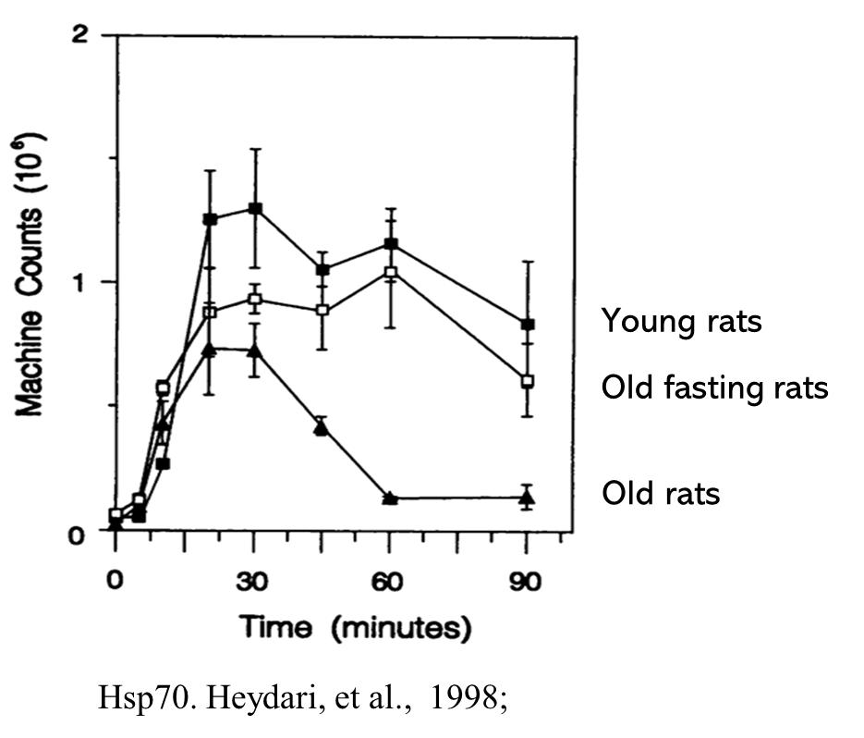
Characteristic feature of aging cell is a significantly reduced expression of Hsp70
Dramatic reduction of expression of inducible Hsp70 correlates with a decrease in the ability of cells to cope with stress.
Malfunction in expression of hsp70 in response to stress is a common phenomenon underlying the senescence and aging progression
Hsp70 and FOXO are considered as pharmacological targets for antiaging therapies

Slide 56
Cytoprotective and effect of Hsp70 is not the only beneficial effect of this molecular chaperone in aging and longevity.
Hsp70 plays an important role in regulation of apoptosis and longevity by inhibition of stress activated JNK-mediated apoptosis signaling pathway.

Slide 57
Ageing and antiaging programs
When cells are exposed to protein damage, HSF1 initiates the production of Hsp70, which repairs proteins, increases adaptability and lifespan.
Oxidative stress can trigger two signaling pathways through the activation of JNK kinase:
the aging program by up-regulation of p-53 transcription factor and
the anti-aging program, which is Hsp70-dependent.
At young ages, activation of HSF1-Hsp70 inhibits JNK-mediated aging, senescence, and apoptosis pathway
Oxidative stress
in youth
HSF1
JNK
Hsp70
P53
Anti-aging
Apoptosis, senescence
Aging
Inhibition
Activation

Slide 58
Ageing and antiaging programs
With aging, induction of Hsp70 is depressed, and the balance shifts in favor of the aging and apoptosis programs. Consequently, even weak oxidative stress can induce the degeneration of neuronal cells and the progression of aging-related diseases
In aging cells, significantly reduced expression of heat shock protein Hsp70 and its precursor, heat shock transcription factor HSF1, correlates with a decreased ability to cope with stress.
In most humans, decline in induction of Hsp70 by stress is associated with aging and age-related disease .
Hsp70 does not decrease with age in some individuals who live more than 100 years.
In brain cells, the inhibition of HSF1 and Hsp70 expression occurs in Alzheimer’s disease.
Age-related decline of hepatic Hsp70 expression contributes to reduced liver detoxification.
Attenuation of Hsp70 is associated with up-regulation of stress-activated protein kinase (JNK) dependent apoptosis and progression of cancer.
Oxidative stress
with age
HSF1
JNK
Hsp70
P53
Anti-aging
Apoptosis, senescence
Aging
Inhibition
Activation

Slide 59


Effects of ADAPT on key regulators of aging
ADAPT-232 upregulates HSF1-Hsp70 in vitro and Hsp70 in vivo;
ADAPT-232 down-regulates JNK in vivo;
ADAPT-232 inhibits aging, senescence, and apoptosis in vivo.
Exercise can also up-regulate Hsp70 contributing to maintenance of muscle fiber integrity, regeneration and recovery.
Conversely, Hsp70 expression is reduced during muscle inactivity and aging.
Malfunction of HSP70 generation may drive muscle atrophy, contractile dysfunction, and reduced regeneration.
Oxidative stress
ADAPT-232
with age
HSF1
JNK
ADAPT-232
Hsp70
P53
Anti-aging
Apoptosis, senescence
Aging
Inhibition
Activation
Panossian A, Gerbarg P. 2016. “Potential Use of Plant Adaptogens in Age-related Disorders”. Complementary, Alternative, and Integrative Interventions in Mental Health and Aging. H. Lavretsky, M. Sajatovic & C.F. Reynolds III, Eds.: 197-211. New York: Oxford University Press.

Slide 60
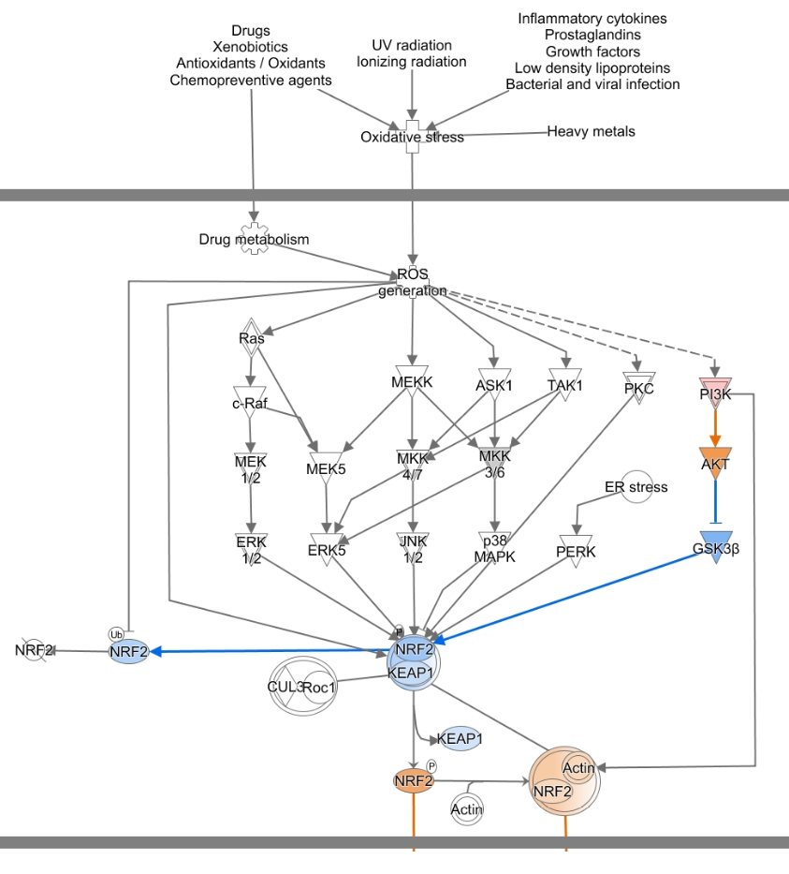
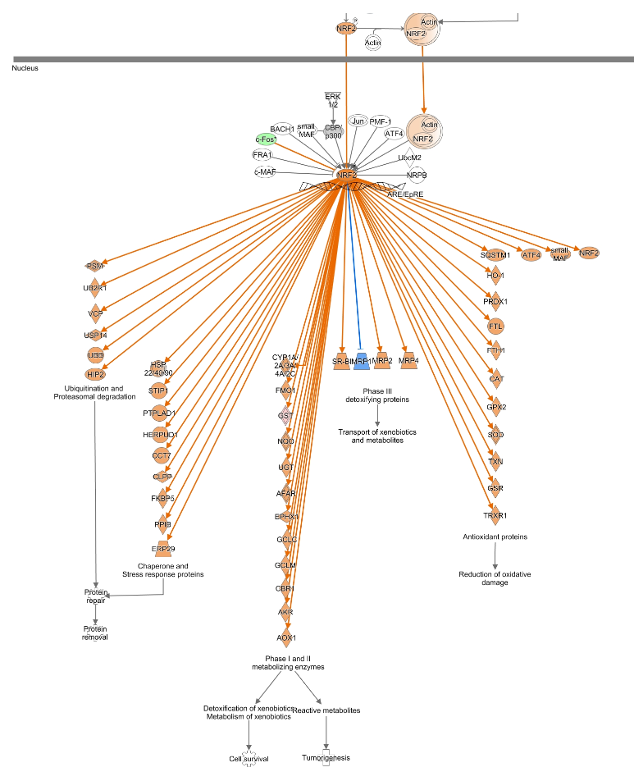
Effect of adaptogens on NRF2-mediated
Oxidative Stress Response Signaling Pathway
Eletheurococcus
Nrf2
Oxidative stress is increasing in Alzheimer disease and aging related diseases and disorders.
The feedback cellular response is associated with activation of defense mechanisms including induction of antioxidant and detoxifying enzymes and molecular chaperons.
Nuclear factor erythroid 2-related factor 2 (Nrf2) is a principal regulator of the redox homeostasis normally retained in the cytoplasm, where it is associated Keap1 protein.
Upon exposure of cells to oxidative stress, Nrf2-Keep complex dissociates and Nrf2 translocate to the nucleus where it triggers expression of antioxidant and detoxifying genes including, superoxide dismutase (SOD), glutathione S-transferase (GST), NAD(P)H quinone oxidoreductase 1 (NQO1) and heme oxygenase 1 (HO1).
Thus, activation of Nrf2 translocation or upregulation of genes expression resulting in activation of Nrf2 signaling pathway is the key mechanism of cellular defense associated with antioxidant effects of medicinal plants and particularly of adaptogenic plants, which are useful in stress and aging related diseases.

Slide 61
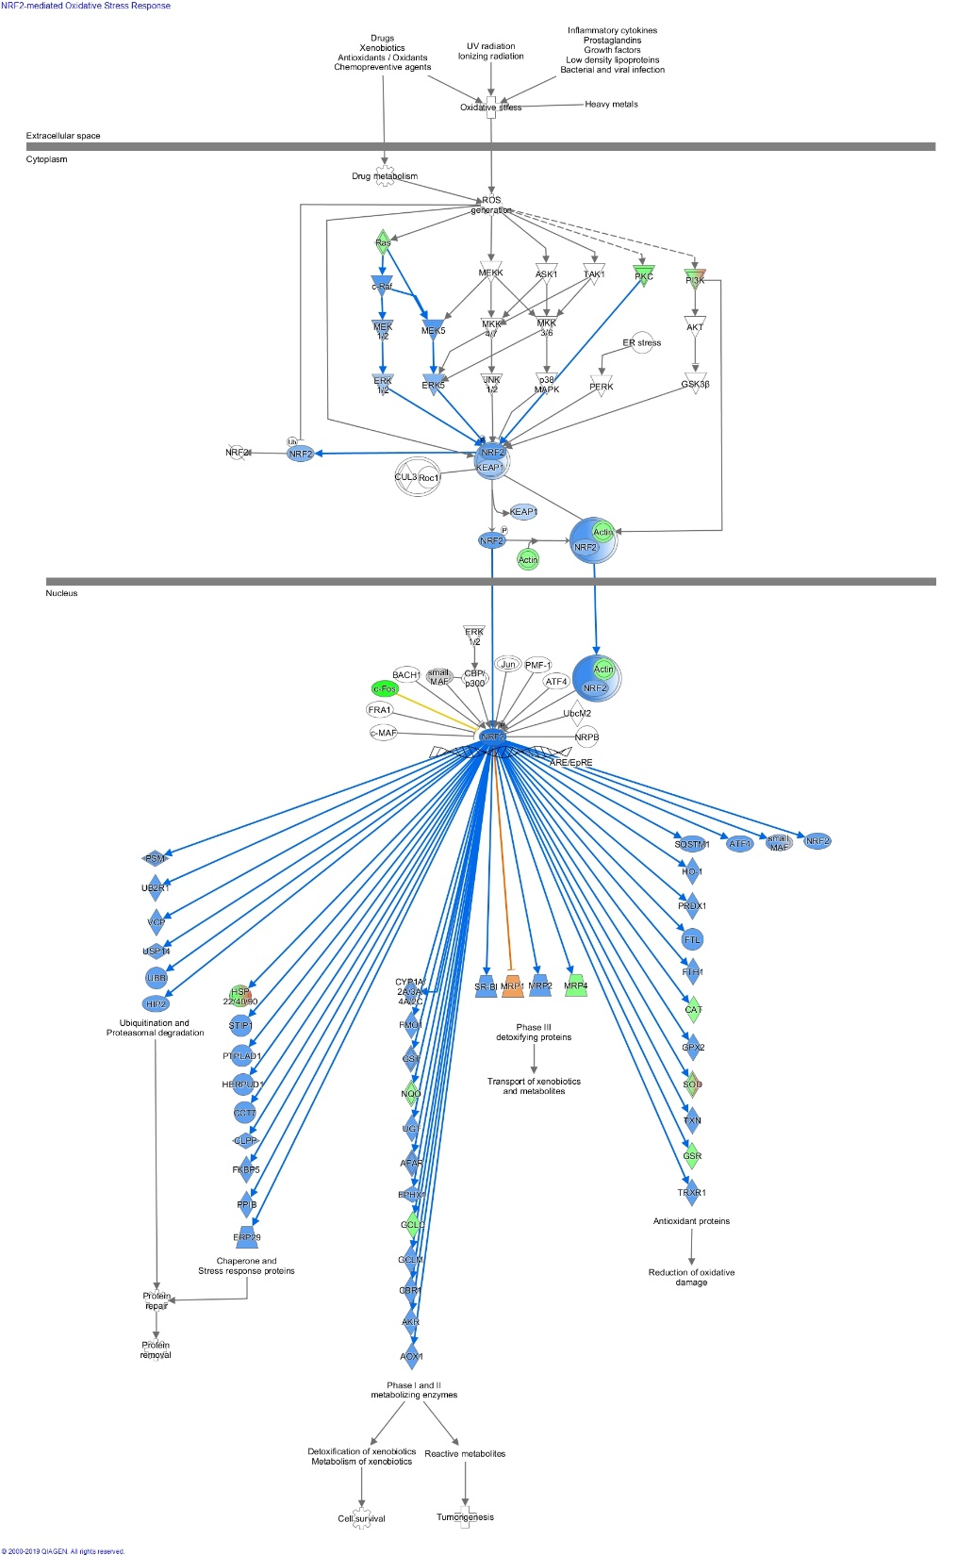
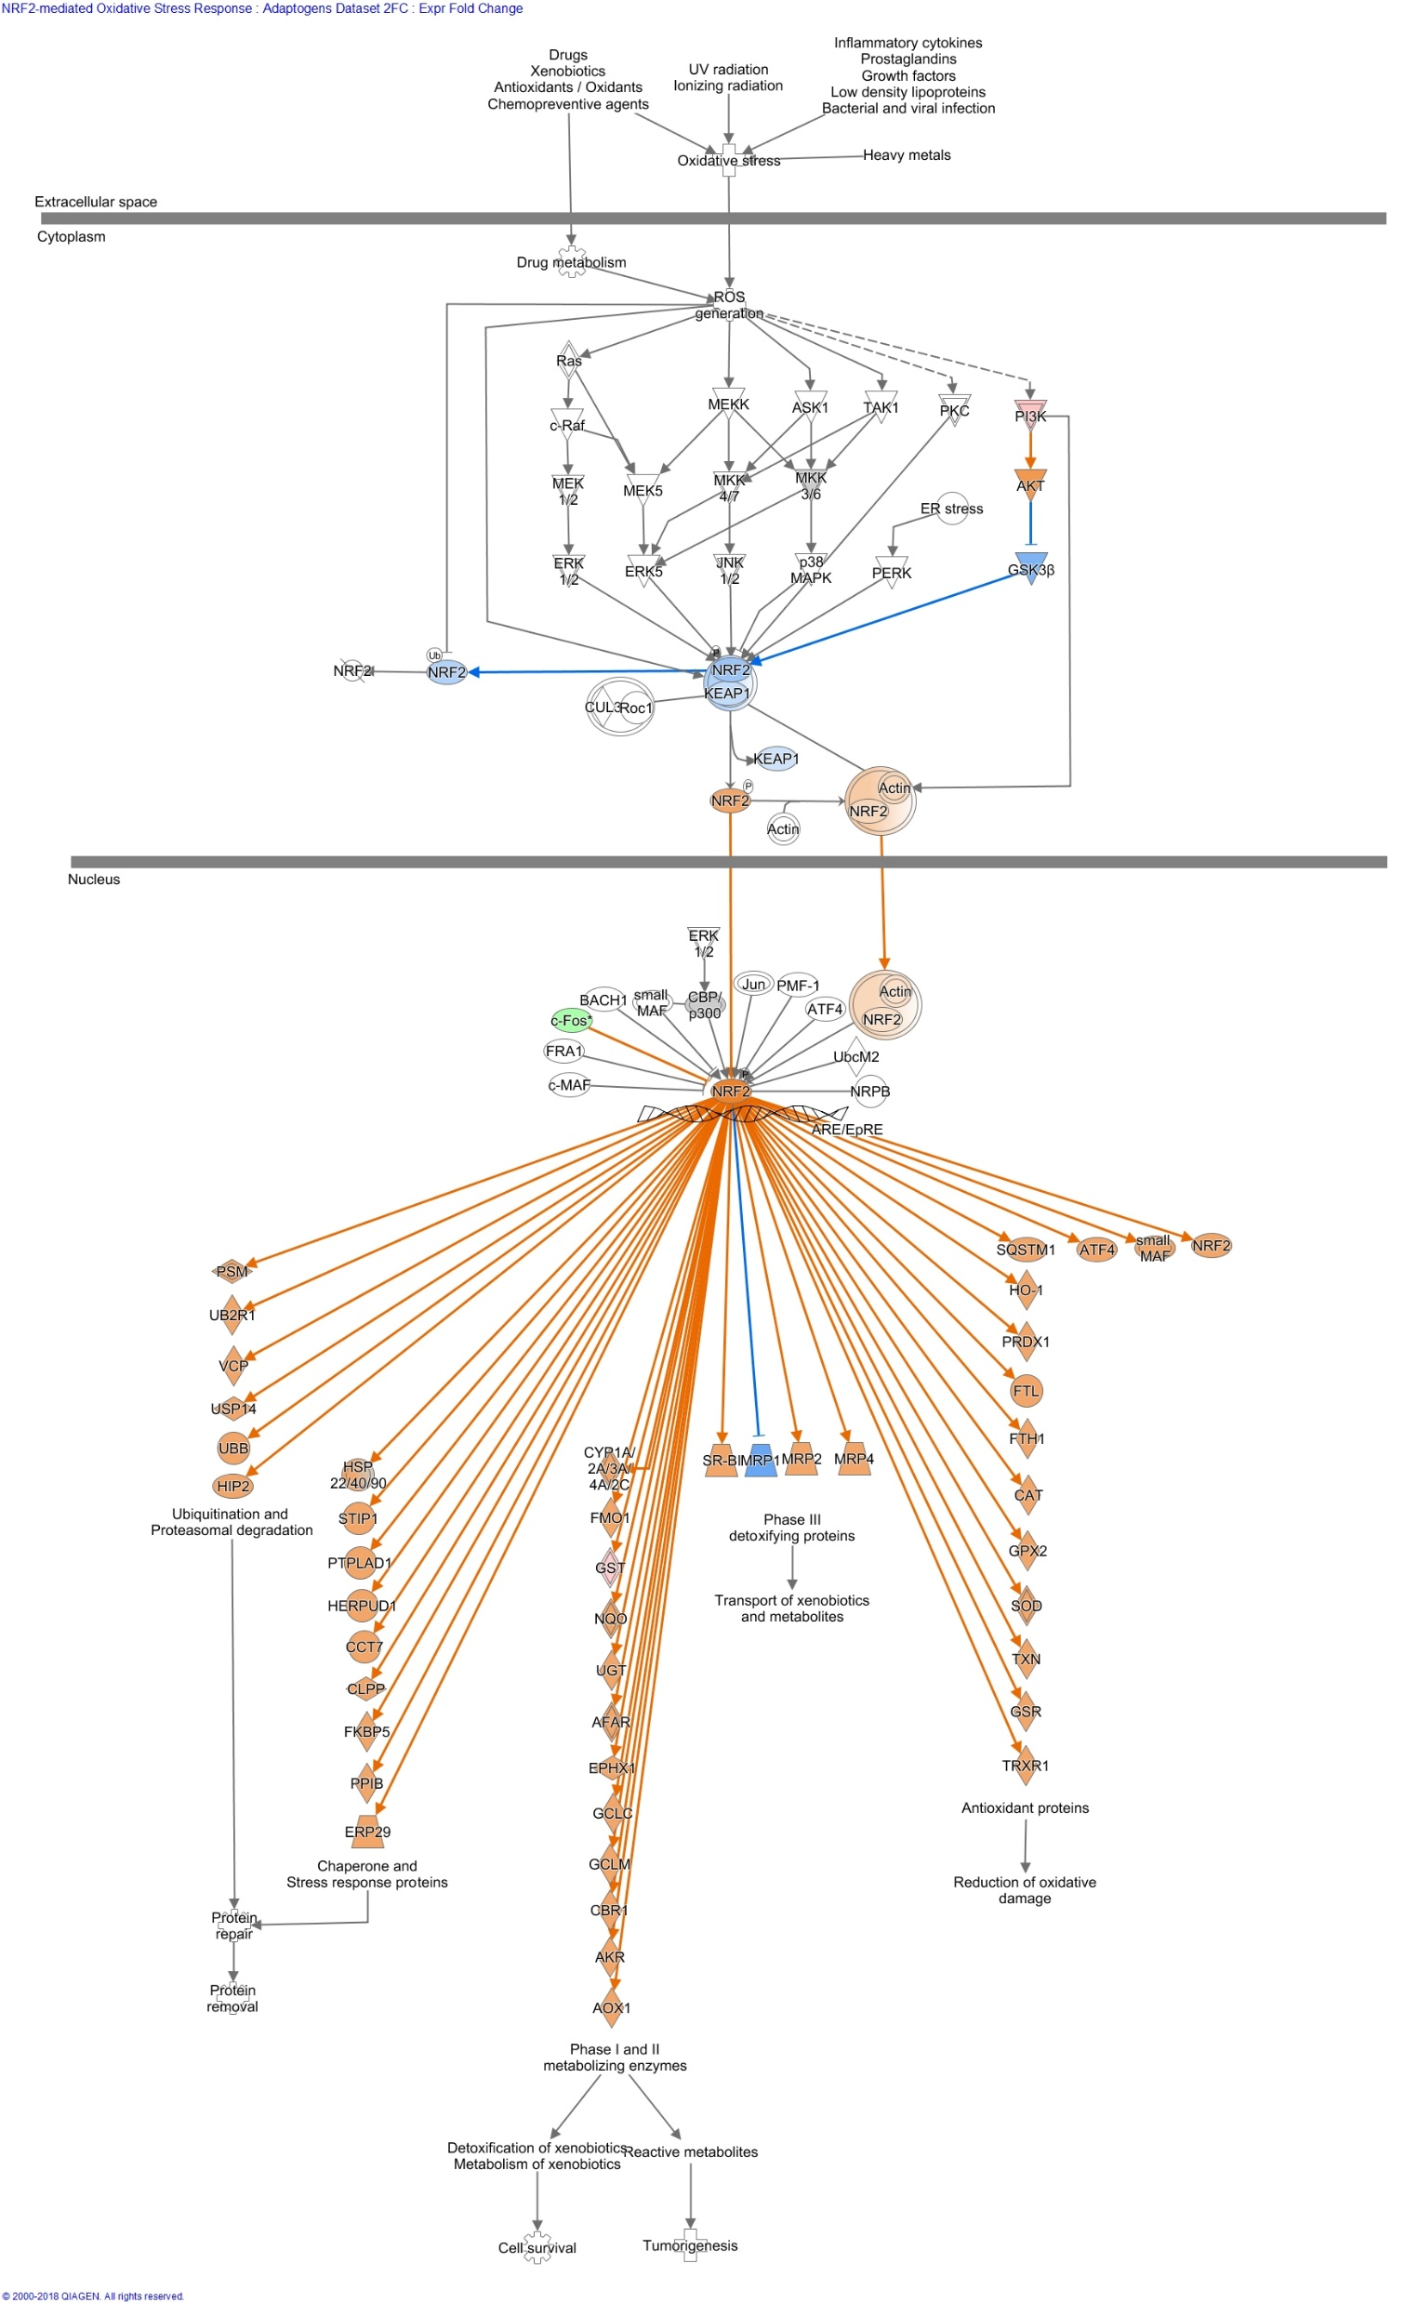
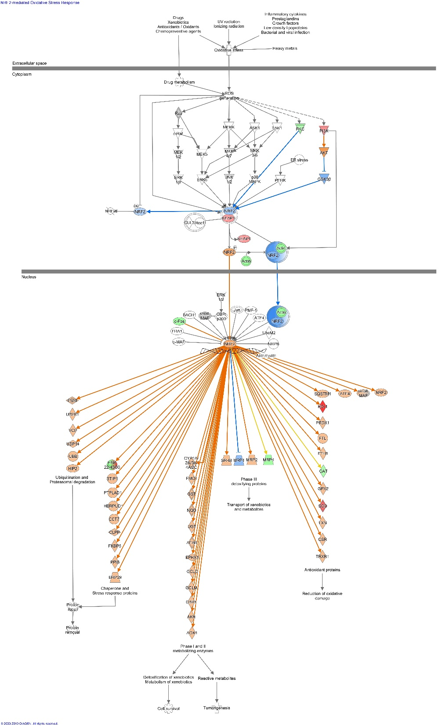
5-fluorouracil + epirubicin + cyclophosphamide=FEC
FEC+ES
FEC+ADAPT
Ras
PKC
PI3K
PI3K
KEAPI
Nrf2
Nrf2
Nrf2
Phase III
metabolizing enzymes
Antioxidant proteins
Antioxidant proteins
Chaperons and Stress response proteins
Chaperons and Stress response proteins
Protein repair
Protein repair
Reduction of oxidative damage
Phase I and II
metabolizing enzymes
Reduction of oxidative damage
Detoxification of xenobiotics
Reactive metabolites
Survival
Detoxification of xenobiotics
Tumorigenesis

Slide 62
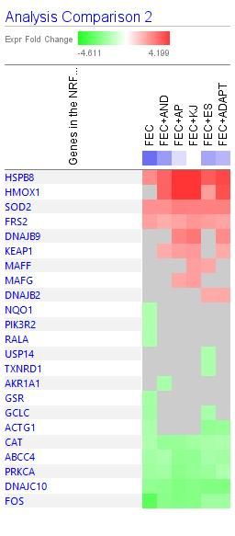
Adaptogens prevent chemotherapeutics-induced downregulation of genes activating production of antioxidant and detoxifying proteins and
upregulate genes Involved in reduction of oxidation damage
Symbol | Entrez Gene Name | FEC | FEC+AND | FEC+AP | FEC+KJ | FEC+El | FEC+ADAPT
GSR | glutathione-disulfide reductase | -1.85
GCLC | glutamate-cysteine ligase catalytic subunit | -1.93 |  |  |  | -1.77
NQO1 | NAD(P)H quinone dehydrogenase 1 | -1.63
PIK3R2 | phosphoinositide-3-kinase regulatory subunit 2 | -1.66
RALA | Ras-related protein Ral-A | -1.67
ACTG1 | actin gamma 1 | -1.75 |  |  |  | -2.22 | -2.11
HMOX1 | heme oxygenase 1 |  | 3.23 | 4.76 | 5.70 | 2.01 | 3.62
KEAP1 | kelch like ECH associated protein 1 |  | 1.72 | 2.04 | 2.11 |  | 1.75
MAFF | MAF bZIP transcription factor F |  |  |  | 1.98 | 1.84
MAFG | MAF bZIP transcription factor G |  |  | 1.82 | 1.98
DNAJB2 | DnaJ heat shock protein family (Hsp40) member B2 |  |  |  |  | 1.74 | 1.78
DNAJB9 | DnaJ heat shock protein family (Hsp40) member B9 |  |  | 2.54 | 2.81 |  | 2.39

Slide 63
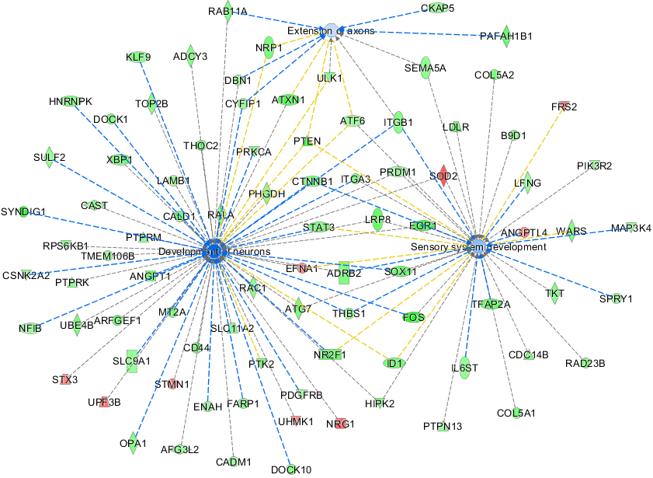
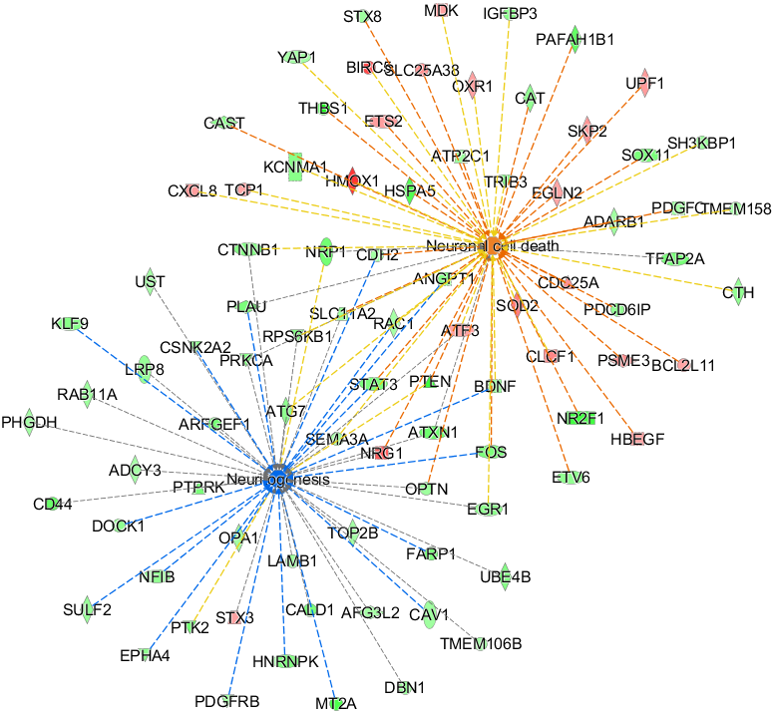
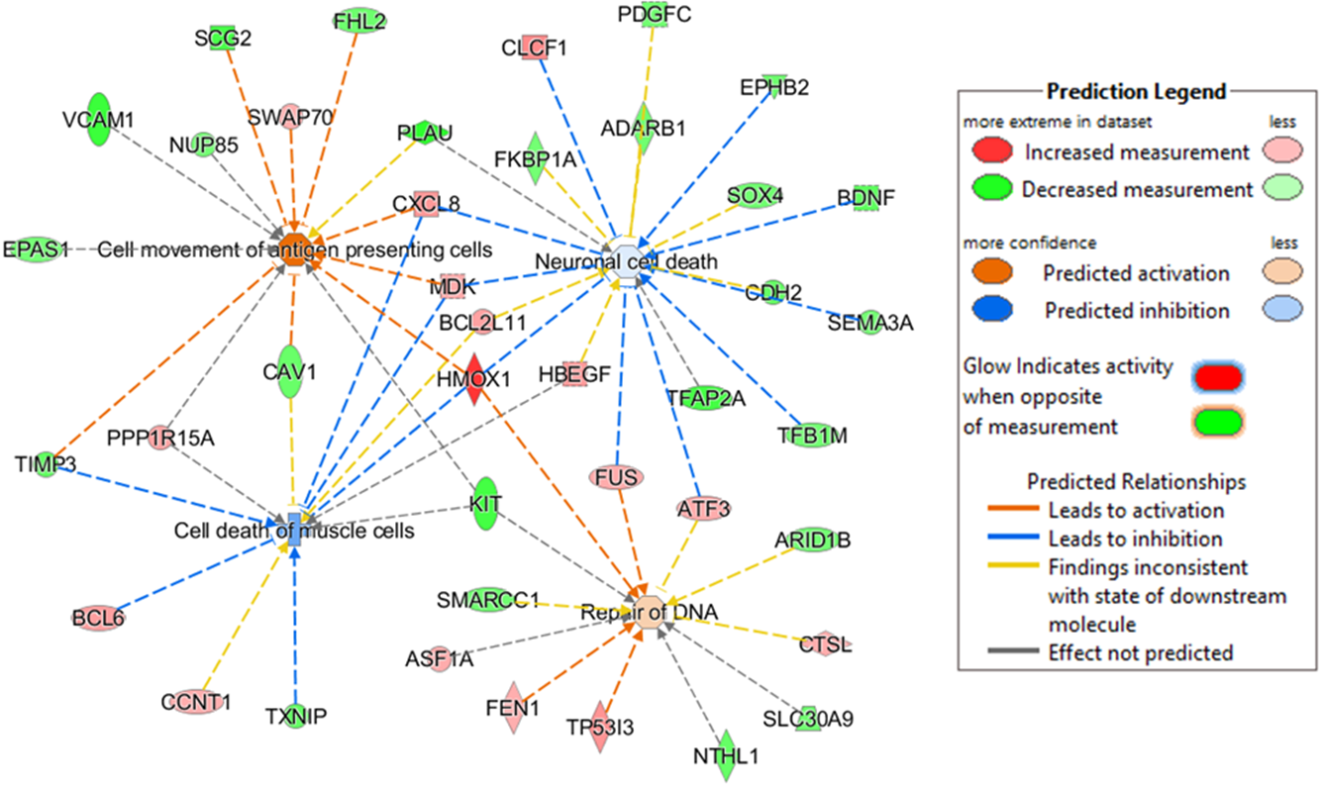
Co-incubation of T98G neuroglial cells with AP suppresses FEC-induced deregulation of large number of genes involved in predicted activating neuronal death and inhibiting neurogenesis
FEC inhibits large numbers of genes involved in the regulation of nervous system development and functions in T98G neuroglial cells
Co-incubation of AP with FEC activates genes involved in DNA repair, movement of antigen presenting cells, and inhibition of neuronal cells death in human T98G neuroglia cell culture.

Slide 64
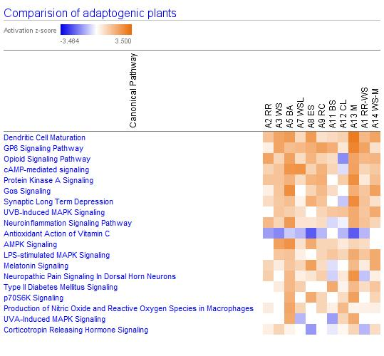
Adaptogens activate melatonin signaling pathway, therefore should be beneficial in sleep disorders and mild cognitive impairment in ageing
With age, the level of night melatonin decreases.

Slide 65
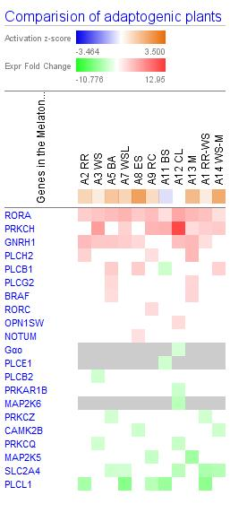
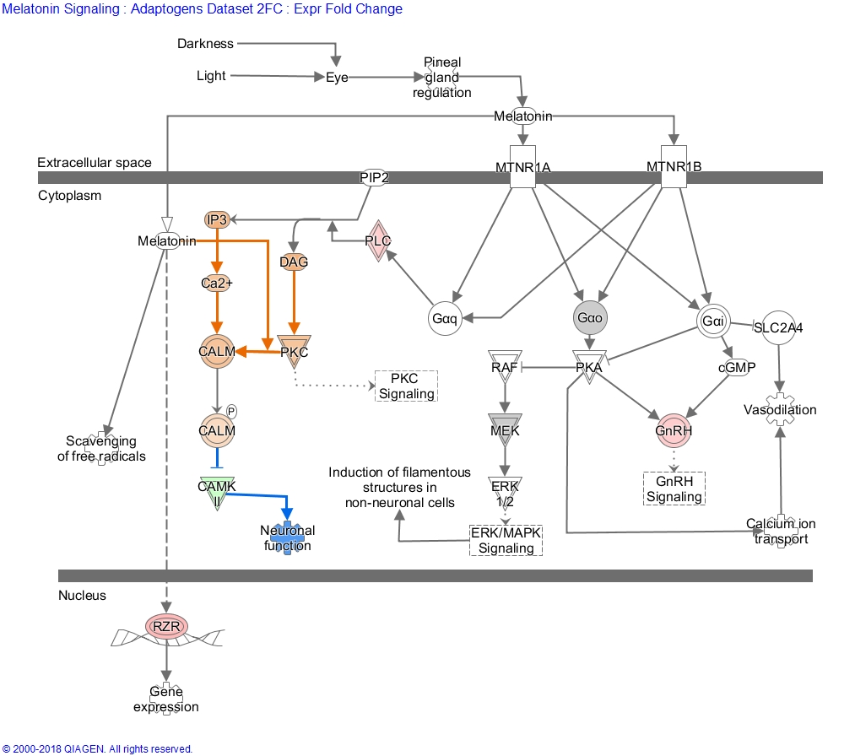
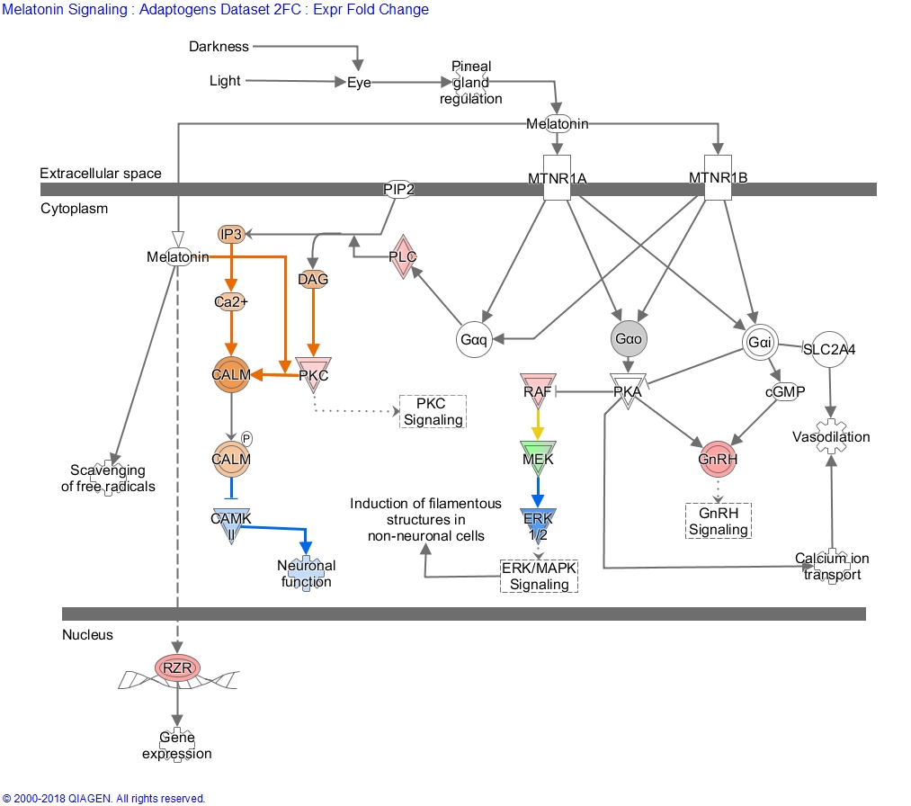
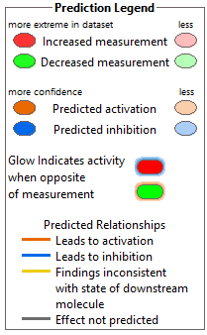
Gene maps of melatonin signaling pathway
Eleutherococcus (ES)
Melatonin
Adaptogens activate the melatonin signaling pathway mainly by upregulation of the ligand-specific nuclear receptor RORA, which plays a role in intellectual disability, neurological disorders, retinopathy, hypertension, dyslipidemia, and cancer, which are common in aging.

Slide 66


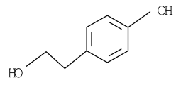

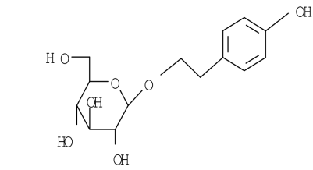
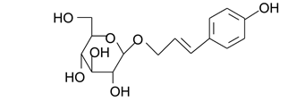
Assessment of adaptogens using systems pharmacology approach, molecular biology technologies and in silico models
RNA hybridization-based Microarray or
RNA-Seq next-generation sequencing
Radix
Rhodiola
Data Analysis using Ingenuity Pathway Analysis (IPA)
Interactive pathways downstream effect analysis
SHR
-
5 extract
Rhodiola modulates expression of genes deregulated in:
cardiovascular diseases (72 deregulated genes),
metabolic diseases (63 genes),
gastrointestinal diseases (163 genes),
neurological diseases (95 genes),
endocrine disorders (60 genes),
behavioral disorders (50 genes),
psychological disorders (62 genes).
Gene Expression
profiling
Human neuroglia cells
IPA software (QIAGEN Bioinformatics), performs different calculations on transcriptomic datasets based on the Ingenuity Knowledge Base, containing approximately 5 Mio findings manually curated from the biomedical literature or integrated from third-party databases.

Slide 67
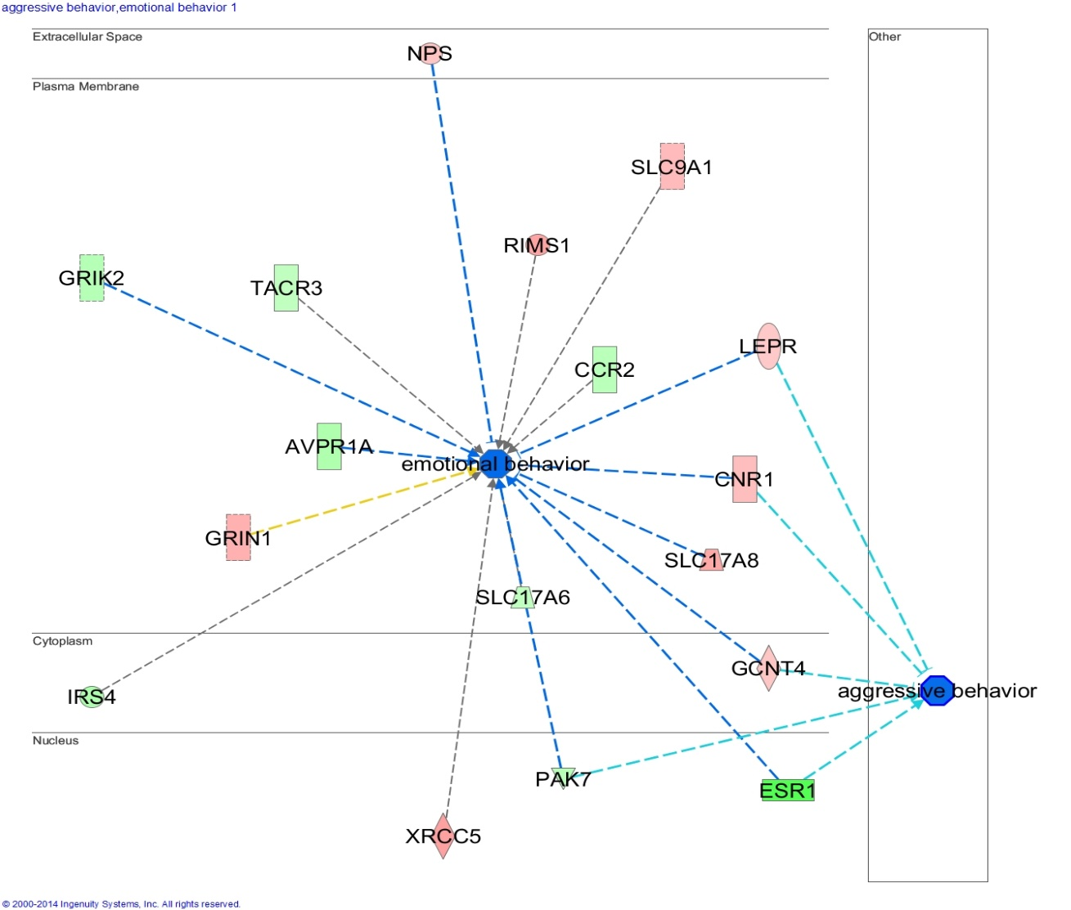
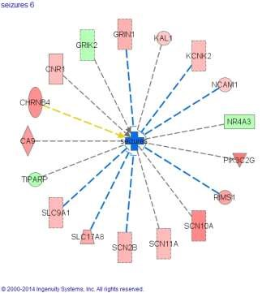
The effects of Rhodiola on molecular network associated with emotional behavior, aggression and seizures
ESR1

Slide 68


Effect of Rhodiola on eicosanoids signaling pathways
Inhibition of 12-HETE mediated neurotoxicity
Inhibition of leukotrienes in Alzheimer disease is associated with:
neuronal survival,
neurogenesis,
neuroinflammation,
blood-brain barrier integrity,
plague load, synaptic integrity,
Tau phosphorylation.

Slide 69
Main biochemical processes most influenced (in terms of altered gene activity) by Rhodiola, Eleutherococcus, and Schisandra.
catabolism of cyclic AMP and metabolism of cyclic GMP conversion of leukotriene A4 and lipoxin A4 oxygenation of docosahexaenoic acid synthesis of synthesis of steroid and bile acid translocation, exchange and redistribution of cholesterol ester and triacylglycerol transmission of triacylglycerol and phosphatidylcholine inactivation of glucocorticoid efficacy of beta-estradiol decarboxylation of beta-alanine and L-aspartic acid deamination of cytidine removal of hypoxanthine | Genes AICDA, AIPL1, AKR1D1, ALOX12, APOBEC2, CETP, ESR1, GADL1, NR4A3, PDE11A, PDE3A, PDE4D, PFKFB1, SERPINA1, SLC27A2
Panossian 2017, Ann. N.Y. Acad. Sci. 1401(1):49-64.

Slide 70
Main cellular functions most influenced (in terms of altered gene activity) by Rhodiola, Eleutherococcus, and Schisandra.
Cellular function | Genes
Cellular Compromise: oxidative stress response of blood cells degranulation of beta islet cells damage of mitochondria degeneration of hepatocytes cytotoxicity of cytotoxic T cells fragmentation of photoreceptor outer segments degeneration of retinal cone cells | AIPL1, ALOX12, CDHR1, NGB3, GNLY, HLA-B, NCAM1, SERPINA1, ULBP3,XRCC5,
Cell Signalling | PDE3A, MUC20, PDE4D, PDE11A, ESR1, CCKBR
DNA Replication, Recombination, and Repair | PARPBP, PDE3A, APLF, PDE4D ,PDE11A, XRCC5, AICDA
Nucleic Acid Metabolism | PFKFB1,MTNR1A,PDE3A,APOBEC2,TAAR1,PDE4D,PDE11A,AIPL1,ESR1,AICDA
Lipid Metabolism | NR4A3,RGS3,SLC27A2,AKR1D1,TNXB,SERPINA1,ALOX12,ESR1,CCKBR,CETP,NCAM1
Panossian 2017, Ann. N.Y. Acad. Sci. 1401(1):49-64.

Slide 71
The most significantly affected canonical pathways and gene targets that are responsive (in-vitro) to adaptogen therapy .
Canonical Pathways | Genes
tRNA Splicing | PDE3A,PDE4D,PDE11A
Protein Kinase A Signaling | PDE3A,HIST1H1T,CNGB3,PDE4D,PDE11A,PLCD4,DUSP21,TCF7L2
G-Protein Coupled Receptor Signaling | PDE3A,TAAR1,PIK3C2G,PDE4D,PDE11A,AVPR1A
Leptin Signaling in Obesity | PDE3A,PIK3C2G,PLCD4
Cardiac β-adrenergic Signaling | PPP1R1A,PDE3A,PDE4D,PDE11A
Relaxin Signaling | PDE3A,PIK3C2G,PDE4D,PDE11A
cAMP-mediated signaling | PDE3A,TAAR1,CNGB3,PDE4D,PDE11A
Salvage Pathways of Pyrimidine Nucleotides | APOBEC2,AK9,AICDA
Colorectal Cancer Metastasis Signaling | MMP8,TLR8,PIK3C2G,WNT16,TCF7L2
Inositol Pyrophosphates Biosynthesis | PPIP5K1
Airway Pathology in Chronic Obstructive Pulmonary Disease | MMP8
Axonal Guidance Signaling | NTNG1,EPHB1,RGS3,MMP8,PIK3C2G,WNT16,PLCD4
Superpathway of Inositol Phosphate Compounds | PPP1R1A,PIK3C2G,PPIP5K1,PLCD4
Sperm Motility | CNGB3,PDE4D,PLCD4
Telomere Extension by Telomerase | XRCC5
Melatonin Signalling and degradation | MTNR1A,PLCD4, UGT2A3,CYP4X1
Role of Osteoblasts, Osteoclasts and Chondrocytes in Rheumatoid Arthritis | MMP8,PIK3C2G,WNT16,TCF7L2
eNOS Signalling | PIK3C2G,CNGB3,ESR1
Panossian 2017, Ann. N.Y. Acad. Sci. 1401(1):49-64.

Slide 72
Age associated disease, and the genes involved in their pathogenesis and progression, that are significantly deregulated by adaptogens
Category | Diseases | Genes affected by adaptogens
Organismal Injury and Abnormalities | physical disability degeneration of retinal cone cells - inhibition atrophy of gastric mucosa hypoestrogenism postmenopausal vulvar atrophy nociception cone dystrophy pelvic organ prolapse | PDE11A,PDE3A,PDE4D - all upregulated AIPL1- down regulated,CNGB3 upregulated CCKBR- down regulated ESR1- down regulated ESR1б MTNR1A - down regulated, KCNK10, PDE11A,PDE3A,PDE4D,SCN2B - all upregulated CDHR1- down regulated,CNGB3 - upregulated ESR1 - down regulated, SERPINA1 - - upregulated
Inflammatory and Pulmonary Disease | pulmonary emphysema- inhibition bronchiectasis chronic bronchitis chronic obstructive pulmonary disease-inhibition | PDE11A,PDE3A,PDE4D,SERPINA1- all upregulated PDE11A,PDE3A,PDE4D - all upregulated MMP8,MTNR1A – both down regulated PDE11A,PDE3A,PDE4D,SERPINA1- all upregulated
Neurological and psychological Disease | non 24 hour sleep-wake disorder sleep-wake schedule disorder | MTNR1A - down regulated PDE3A- upregulated
Cardiovascular Disease | ischemic cardiomyopathy cholesteryl ester transfer protein deficiency angina pectoris cerebral small vessel disease | PDE11A,PDE3A,PDE4D,PPP1R1A - all upregulated CETP - down regulated PDE11A,PDE3A,PDE4D – all upregulated PDE3A - unregulated
Skeletal and Connective Tissue | osteochondrodysplasia | COL9A1 - down regulated, PDE4D -up regulated
Metabolic Disease | estrogen resistance | ESR1 – down regulated
Panossian 2017, Ann. N.Y. Acad. Sci. 1401(1):49-64.

Slide 73
The effects of Rhodiola on genes involved in regulating age-associated disorders
Inflammation – atherosclerosis –
Down regulation of CETP,
Deregulation of GPCR,
Neurodegeneration – impaired cognitive functions (learning, memory, abstract thinking, planning)
Down regulation of cAMP
Down regulation of ESR1
Upregulation of serpine
Deregulation of GPCR,
Impaired apoptosis – Cancer –
Down regulation of ESR1, OLFM
Up regulation of IP3, PLC, DAG, PI3K, NFkB
Deregulation of GPCR
Metabolic disorders and energy metabolism
Down regulation of cAMP
Inhibition of ATP metabolism

Slide 74

Conclusions
Stress response and adaptation to environmental challenge are multistep processes that involve intracellular and extracellular signaling pathways at all levels of stress regulation.
Adaptogens are stress-response modifiers and have many molecular targets.
Adaptogens exert a polyvalent biological activity and provoke multiple effects at all levels of regulation of cellular metabolism and homeostasis.
Therefore, adaptogens have pharmacologically pleiotropic effects, which explain their traditional use for a wide range of conditions.

